Slide 1
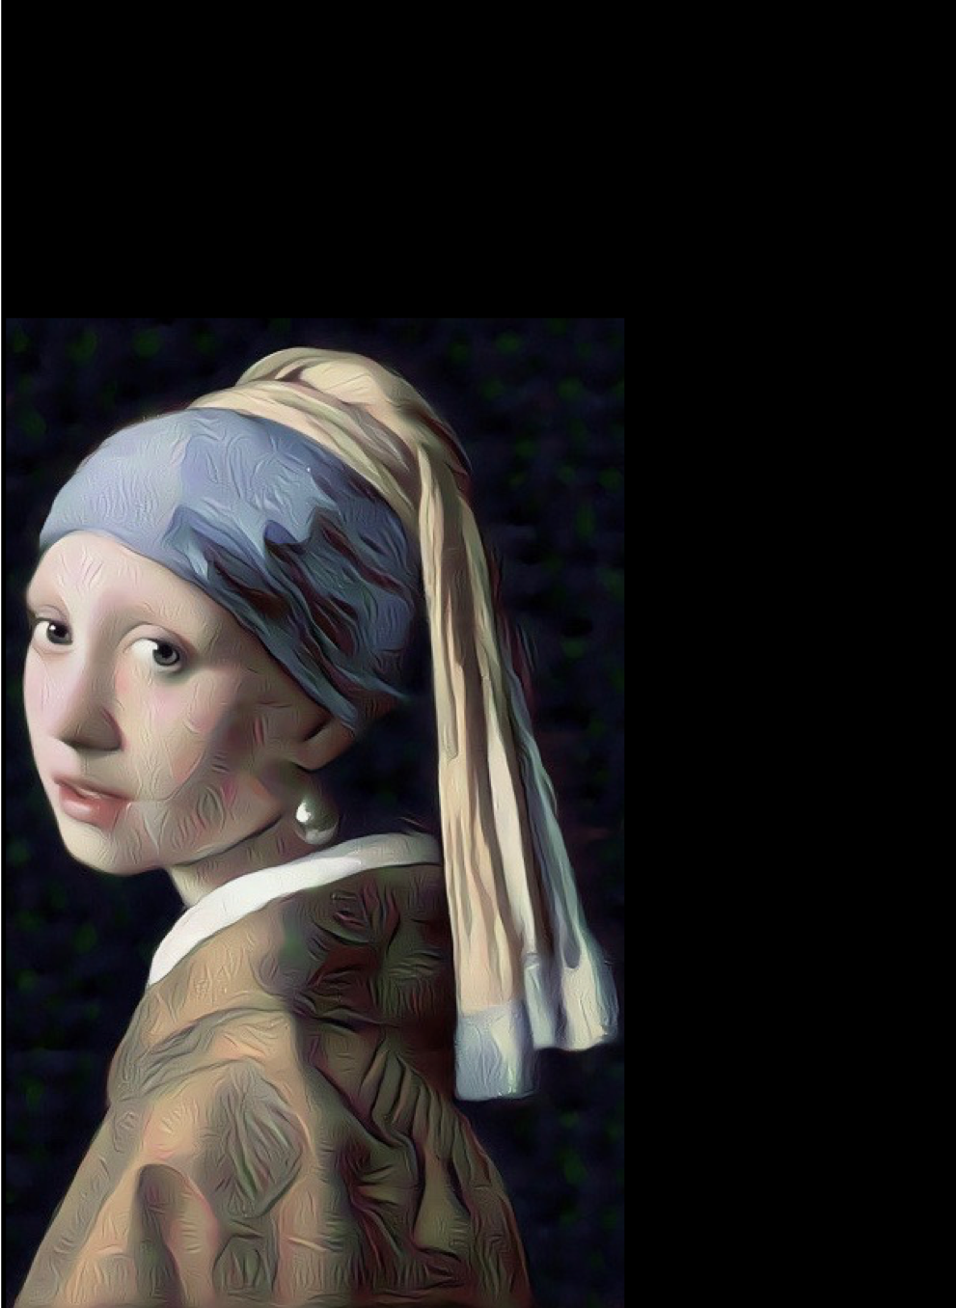
Deep Convolutional Neural Networks for Image Processing
An Overview on Convolutional Neural Networks for Image Classification and Image Segmentation
Delft University of Technology
Franziska Riegger
January 29, 2019
This Photo by Unknown Author is licensed under CC BY-NC

Slide 2
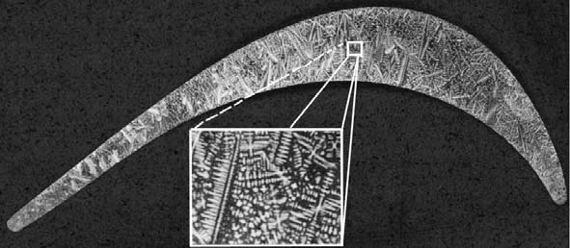
Deep Convolutional Neural Networks for Image Processing
Image Processing: extracting useful information from an image
https://www.researchgate.net/figure/An-overview-image-of-a-dendritic-microstructure-turbine-blade-made-from-Ni-base_fig1_278327694
Option A: safety critical
Option B: shorten maintenance
interval
Option C: no consequences
Notes:
Image processing sounds abstract but actually it is part of daily life of a lot of people
Seems to be wide range however shown examples are mainly either image classification segmentation
Both these classifications can be yield in different ways but lately one in particular has drawn attention
This approach is based on AI and uses so-called Deep Convolutional Networks which are special instances of neural network
Although this already narrows the possibilities of implementation the final neural network depends on the application itself
However, I’d like to given an overview about the basic concept these convolutional neural networks and how they can be applied for this particular image processing tasks
Developed by google for machine learning systems

Slide 3
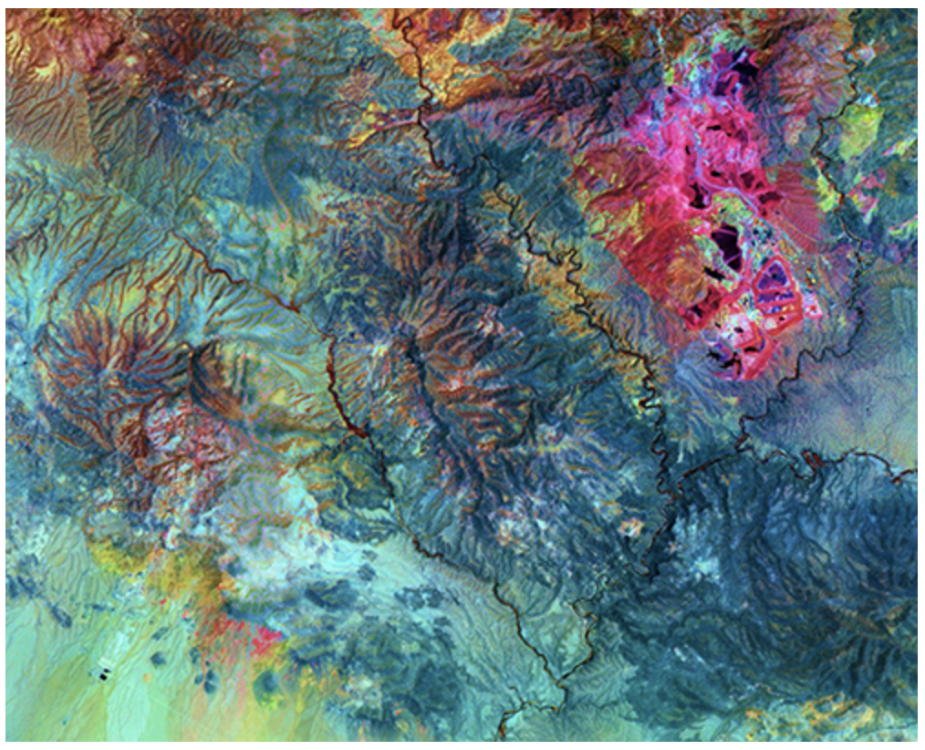
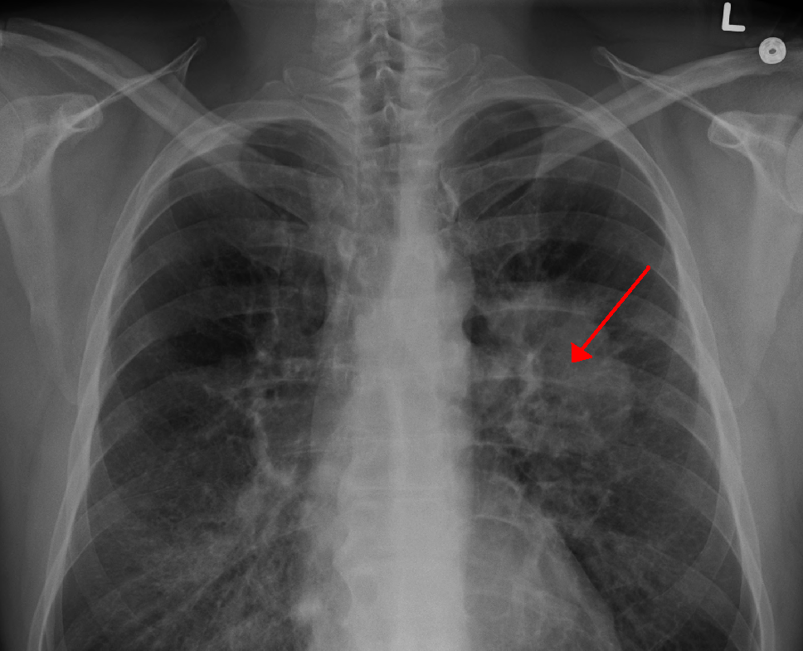
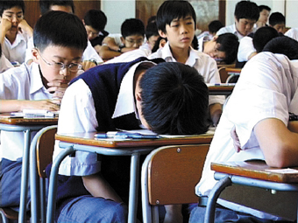


Deep Convolutional Neural Networks for Image Processing
Image Classification
assign image to one class
Image Segmentation
assign each pixel to one class
Deep Convolutional Networks (ConvNets) with software library Tensorflow
Notes:
Image processing sounds abstract but actually it is part of daily life of a lot of people
Seems to be wide range however shown examples are mainly either image classification segmentation
Both these classifications can be yield in different ways but lately one in particular has drawn attention
This approach is based on AI and uses so-called Deep Convolutional Networks which are special instances of neural network
Although this already narrows the possibilities of implementation the final neural network depends on the application itself
However, I’d like to given an overview about the basic concept these convolutional neural networks and how they can be applied for this particular image processing tasks
Developed by google for machine learning systems

Slide 4
Outline
Principles of Machine Learning
Image Classification with ConvNets
Image Segmentation with ConvNets

Slide 5
Principles of Machine Learning
Fully-connected Neural Networks
Improvements

Slide 6
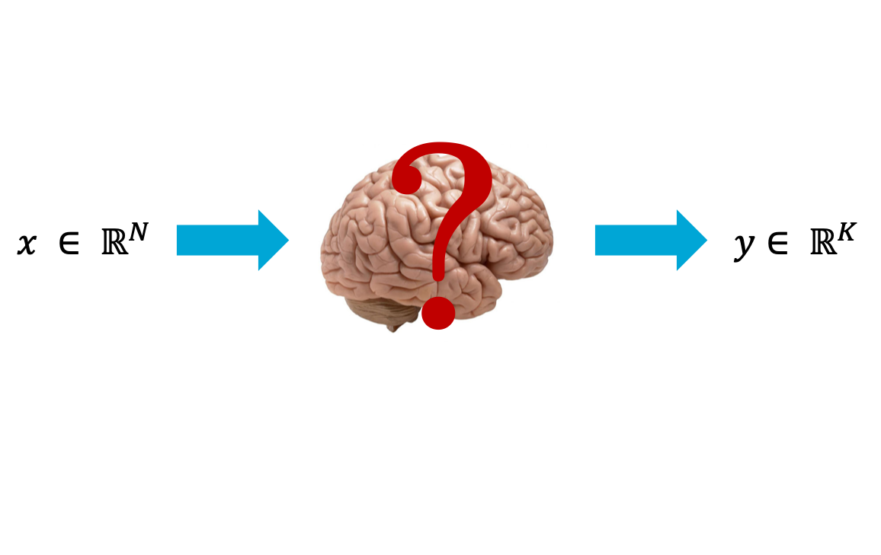
Neural Networks
Learning Problem
Model class
Performance Measure
Training
Validation
Notes:
For most people, neural networks are something where you through in an input and get an output
However, the most interesting part is the process between input and output
This can be separated in 5 steps
First we define the learning problem, that means which input is given and which output do we want
This mapping

Slide 7
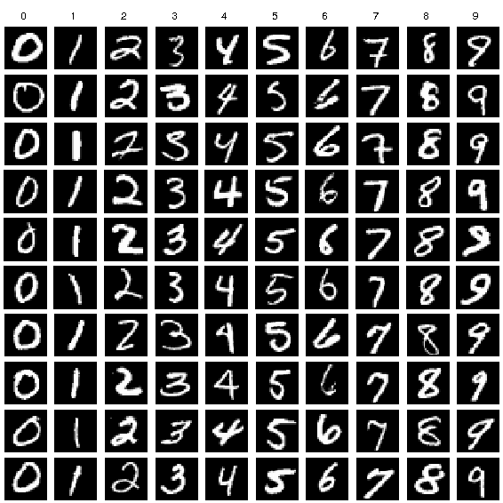
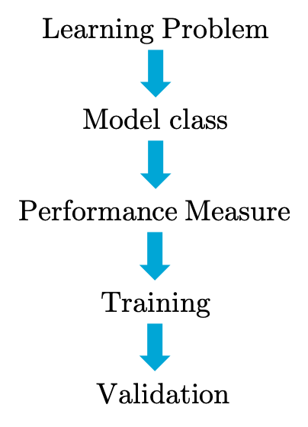
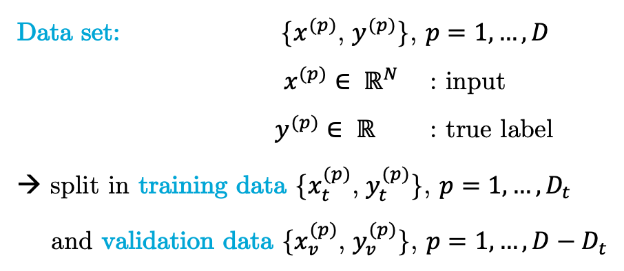
Neural Networks – Learning Problem
Learning Problem: classify digit in an image
Data set: {$x^{(p)}$, $y^{(p)}$}, $p=1, …, D$
$x^{(p)}∈ ℝ^{N}$ : input
$y^{(p)}∈ ℝ$ : true label
→ split in training data {$x_{t}^{(p)}$, $y_{t}^{(p)}$}, $p=1, …, D_{t}$
and validation data {$x_{v}^{(p)}$, $y_{v}^{(p)}$}, $p=1, …, D−D_{t}$
Notes:
The task could be to predict which digit is shown in an image
This is associated with a data set which stored the images and labels
These labels are the solution to the classification problem
Will become relevant in the training stage

Slide 8
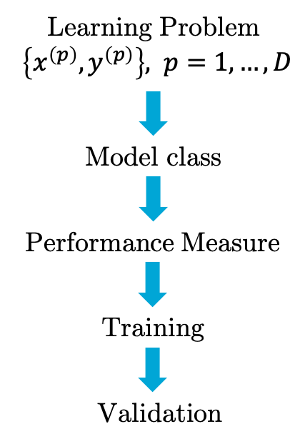












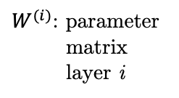






Neural Networks – Model Class
Model Class: $ℝ^{N}⟼ℝ^{K}: x⟼f\left(x,w\right), w∈ Λ$
Fully-connected neural network
: neuron
$$x_{1}$$
$${f(x,w)}_{1}$$
$$⋮$$
$$⋮$$
$$⋮$$
$W^{(i)}$: parameter
matrix
layer i
$$x_{i}$$
$${w_{ji}}^{(1)}$$
$${w_{kj}}^{(2)}$$
$${f(x,w)}_{k}$$
$$⋮$$
$$⋮$$
$$⋮$$
$$x_{N}$$
$${f(x,w)}_{K}$$
$$Input layer$$
$$Hidden layer 1$$
$$Output layer 1$$
Notes:
Stack of multiple layers that has similar structure
Each of them has elements called neurons
All neurons from one layer are connected to all neurons from the following layer
Mathematically this is a matrix multiplication
The result of each multiplication in one layer is the input for the next layer
Output gives the probability that x belongs to one of the K classes

Slide 9
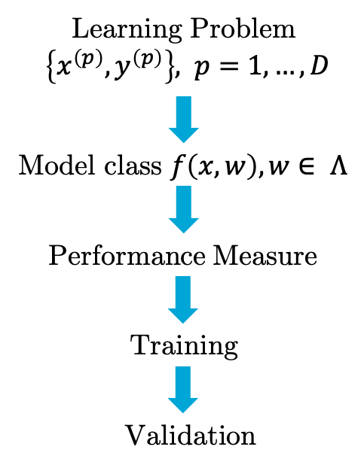


Neural Networks – Performance Measure
Performance measure: classification or generalization error
$$R\left(w\right)=R(y,f\left(x,w\right))$$
Optimal model:
$f\left(x,w_{opt}\right)$ with $w_{opt}=\arg{\min_{w∈Λ}}(R\left(w\right))$
Notes:
But how do we know that this model is good? Optimal model predicts the right digit in any image
Hence model output f(x,w) is equivalent to true label y
Accuracy can also be measured by the error that is done when classify
Hence

Slide 10
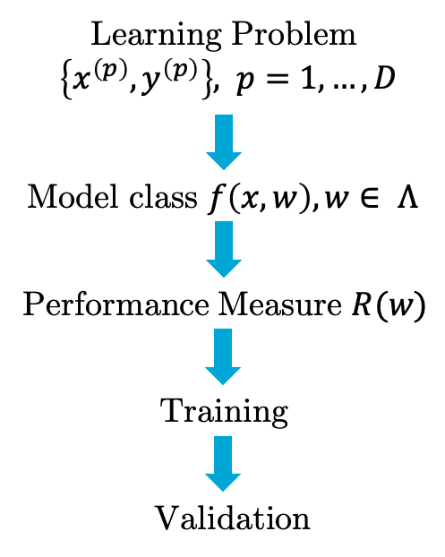


Neural Networks – Empirical Risk Minimization
?
How to optimize for any image if only limited data is available?
Empirical Risk Minimization (ERM)
Minimize $R_{emp}\left(w\right)$ instead of $R\left(w\right)$
training error: $R_{emp}\left(w\right)=R_{emp}\left(w,x_{t}^{(i)} \right)$
Notes:
R_emp is averaged classification error of training set

Slide 11
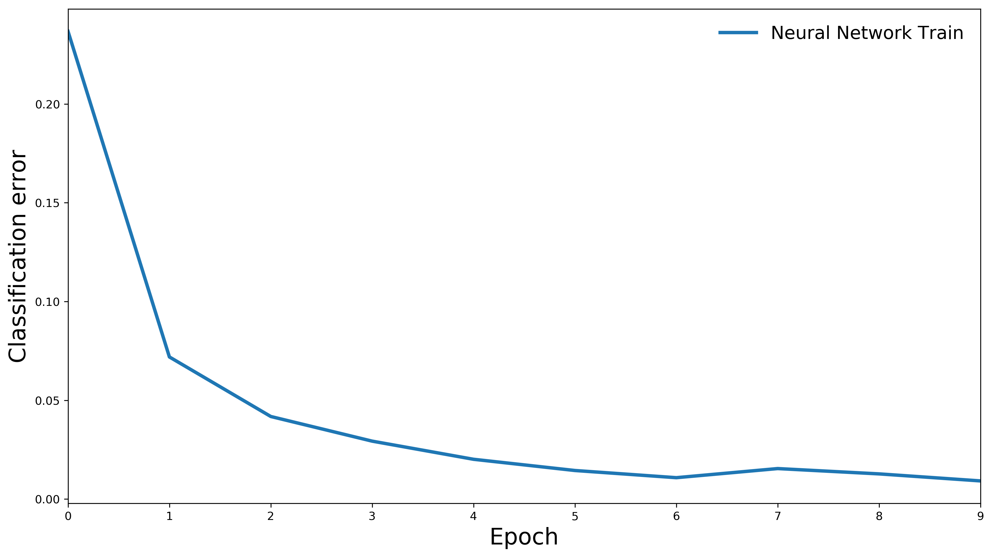


Neural Networks – Training
Training:
optimize $w_{train}=\arg{\min_{w∈Λ}}(R_{emp}\left(w\right))$
classification error $R_{emp}\left(w,x_{t}^{(i)} \right)$
Notes:
iteratively
Shows training error evaluated for training data set!!

Slide 12
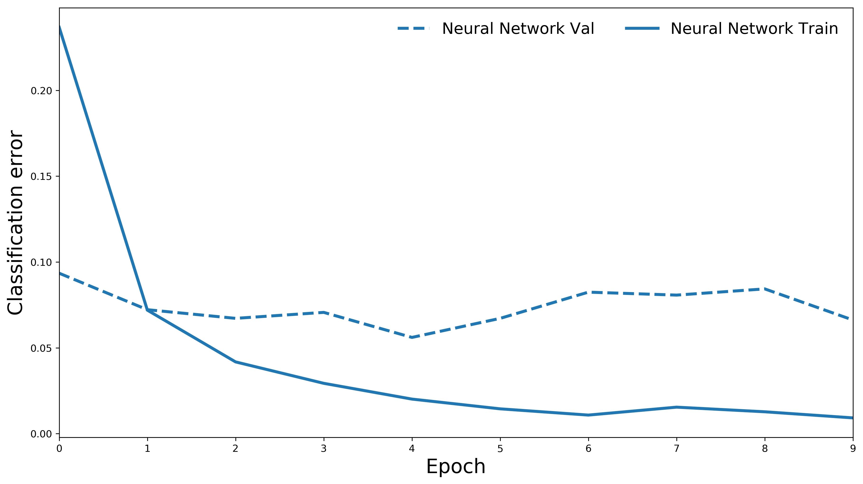
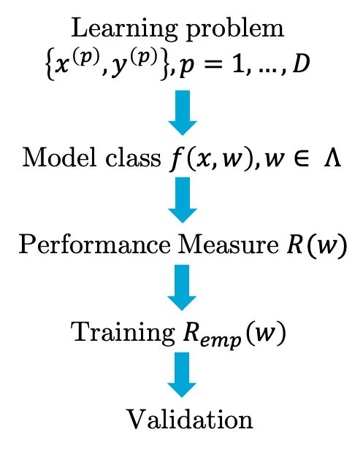
Neural Networks – Validation
measure $R(w_{train})$ with validation set {$x_{v}^{(p)}$, $y_{v}^{(p)}$}
Validation:
overfitting
Notes:
When validating the model we observe a phenomena called overfitting
Indicates bad performance of the model
→ improve!!

Slide 13
Principles of Machine Learning
Fully-connected Neural Networks
Improvements

Slide 14
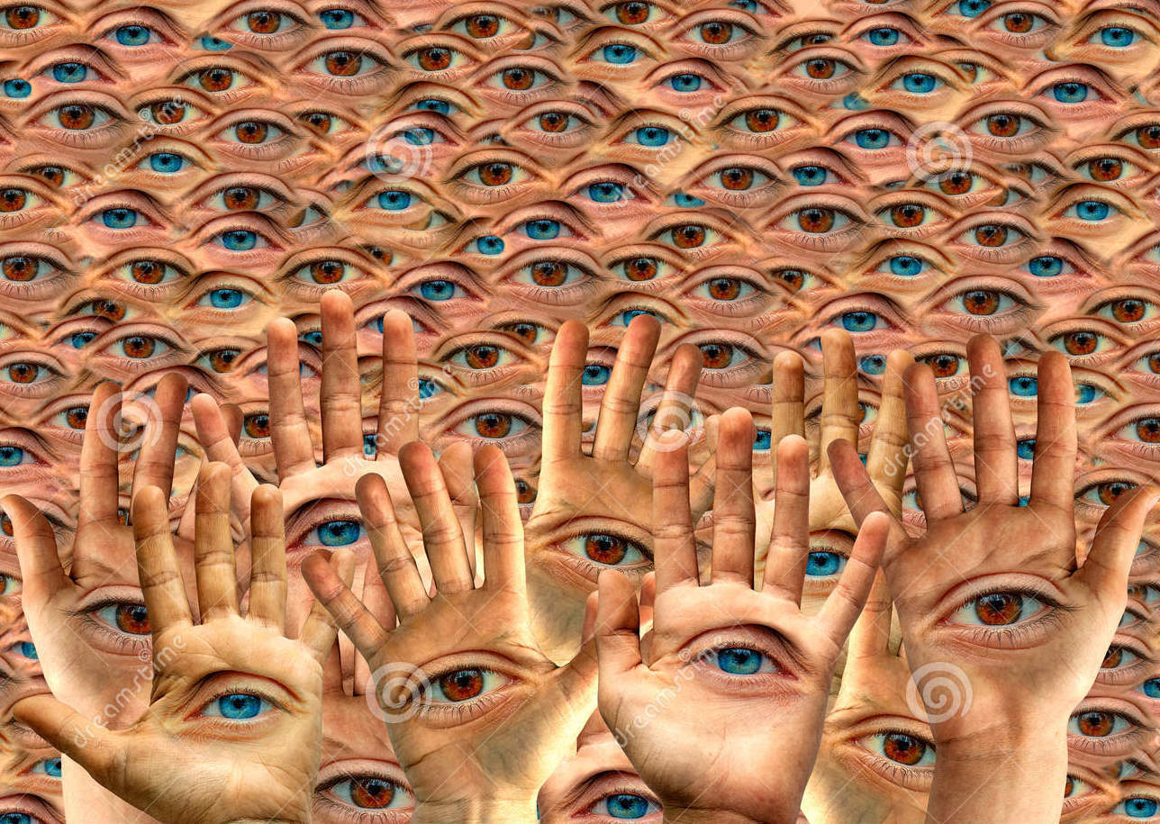
Neural Networks – Troubleshooting
Overfitting Prevention: adapt model to learning problem
Learning Problem: feature extraction
feature: useful information in data
e.g. eye color
Notes:
- One possibility to improve generalization is tailoring model architecture to learning problem
- Leave digit classification aside for a while

Slide 15
Neural Networks – Sparse Connectivity
Status quo network: parameter matrix extracts features in
entire image
Notes:
Fully connected network connects each pixel from input layer with each neuron from a following layer
→ But feature we are interested in, spans only over a few pixel
It suffices to connect these pixels with neurons
Mathematically: substitute matrix multiplication with a disrete convolution that traverses the whole image
Uses specific terminology: matrix that is used is called kernel, the resulting matrix is called feature map

Slide 16
Neural Networks – Sparse Connectivity
Status quo network: parameter matrix extracts features in
entire image
Improvement 1: cover only relevant area
reduce connectivity of parameter
matrix
Discrete convolution with kernel
results in feature map
Notes:
Fully connected network connects each pixel from input layer with each neuron from a following layer
→ But feature we are interested in, spans only over a few pixel
It suffices to connect these pixels with neurons
Mathematically: substitute matrix multiplication with a disrete convolution that traverses the whole image
Uses specific terminology: matrix that is used is called kernel, the resulting matrix is called feature map

Slide 17
Neural Networks – Parameter Sharing
Status quo network: one set of parameter for all features
Improvement 2: one parameter set for
each feature
Notes:
In first hidden layer we have one kernel that detects blue and brown eyes
Intuitively, extraction is more precise if we use specific filters for each feature
We add a second kernel to the first hidden layer
One for blue, one for brown
Each of them result in one feature map
Hence, overall output of first hidden layer is two matrices
Multidimensional data structure is called a tensor

Slide 18
Neural Networks – Parameter Sharing
Status quo network: one set of parameter for all features
Improvement 2: one parameter set for
each feature
results in several feature maps:
matrix → tensor
Notes:
In first hidden layer we have one kernel that detects blue and brown eyes
Intuitively, extraction is more precise if we use specific filters for each feature
We add a second kernel to the first hidden layer
One for blue, one for brown
Each of them result in one feature map
Hence, overall output of first hidden layer is two matrices
Multidimensional data structure is called a tensor

Slide 19
Neural Networks – Convolutional Networks
Learning Problem: feature extraction
layers with multiple discrete convolution instead of one common matrix multiplication
convolutional layer
fundament of convolutional network
Notes:
Network like this behaves in particular well in feature extraction

Slide 20
Image Classification with ConvNets

Slide 21
Image Classification – ConvNets
Simple classifier: fully-connected network
input
image
too simple for images
classifications
classification
Notes:
From previous section we know that a simple fully-connected network can be used as a classifier
However, images are extremely complicated and contain a lot of information and a big part od this information is not relevant for classification
Instead, reduce images to its properties which are necessary to classify and feed only this information to classifier
→ adapt structure

Slide 22
Image Classification – ConvNets
Simple classifier: fully-connected network
too simple for images
feed classifier only with
relevant information
input
image
classifications
additional feature
extraction
feature
extraction
classification
Notes:
From previous section we know that a simple fully-connected network can be used as a classifier
However, images are extremely complicated and contain a lot of information and a big part od this information is not relevant for classification
Instead, reduce images to its properties which are necessary to classify and feed only this information to classifier
→ adapt structure

Slide 23
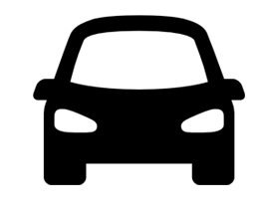
Image Classification – Feature Extraction
Complex concepts
How do we know that this is a car?
wheels, headlights, …
How do we know that this is a wheel?
Simple concepts
horizontal, vertical lines
ConvNets: hierarchical feature extraction
Notes:
Directly recognize this as a car because of headlights, wheels, window
So we realize the complex objects of a car because we recognize simpler components such as wheel headlights etc.
→ easy for us but still too complicated for neural network
→ repeating this question
But what is wheel?
→ again breaking it don’t to simpler concepts and end up with vertical and horizontal lines
→ finally easy enough for NN
They first extract this and then stepwise compose this simple concepts to more complex ones which are again combine until finally object of car
→ feature extraction has a hierarchy

Slide 24
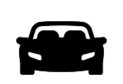
Image Classification – Hierarchical Feature Extraction
Step 1: Simple feature
convolutional layer
Step 2: merge to more complex concept
translation invariance
downsampling layer
Notes:
Absolute position of simple feature change from car to car
→ only relative position relevant

Slide 25
Image Classification – Downsampling
MAX-Pooling: example of downsampling
→ grid-wise application of MAX function
MAX
1
1
2
4
5
6
7
8
6
8
Input feature
map
3
2
1
0
3
4
y
1
2
3
4
x
pooled feature map
invariance towards translation and reduces feature map resolution
Notes:
When generating patterns from simple features their relative position towards each other is not important:
For a car e.g. it is only important to know that they have lights and a kühler, their position depends on vendor

Slide 26
Image Classification – Architecture
Feature extraction: stackwise convolutional and
downsampling stage
Classification: fully-connected network
convolutional layer
input
image
classi-
fications
downsampling layer
feature
extraction
classification
Notes:
Hierarchical approach where stackwise convolution and downsampling layers are applied
In the beginning, very simple features are extracted such as lines which are then composed to more complex objects
The complexer the objects the more layers are needed
But how can they be merged to more complex objects?

Slide 27




Image Classification– The Digits
Data set$\left\{x^{\left(p\right)},y^{\left(p\right)}\right\}, p=1,…,D$
Model class $f\left(x,w\right), w∈ Λ$
Performance Measure: Optimize $R(w)$
Training: Optimize $R_{emp}\left(w\right)$
Validation

Slide 28
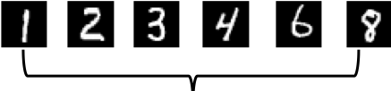








Image Classification – Digits
$$⋯$$
$$⋯$$
$$Pooling$$
$$⋯$$
$$⋯$$
$$Pooling$$
$$Classification$$

Slide 29
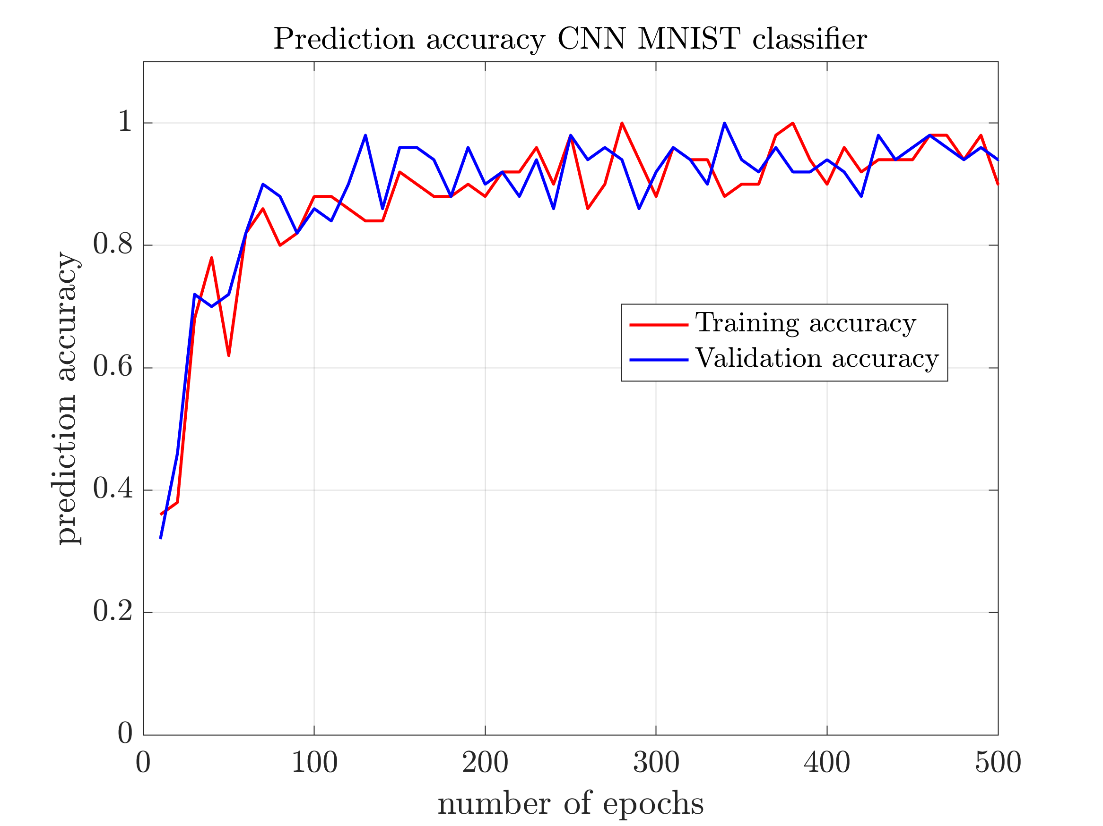
Image Classification – Digits

Slide 30
Image Segmentation with ConvNets

Slide 31
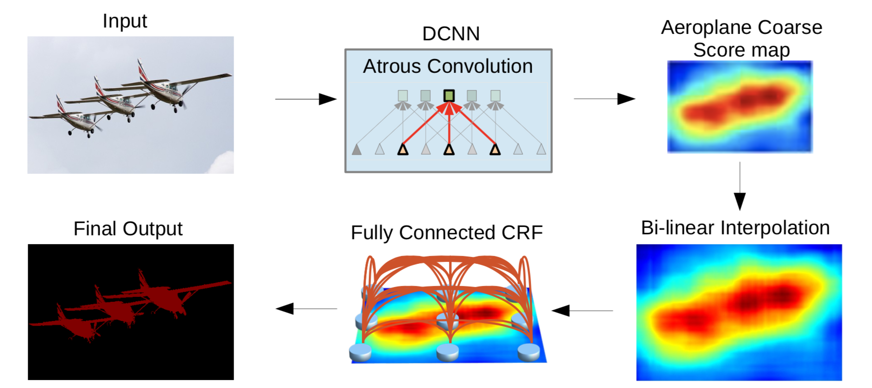
Image Classification vs Segmentation
Image Classification
Image Segmentation
What?
Where?
airplanes
image-wise classification
pixel-wise classification
feature extraction based on
translation invariance
feature extraction with
location

Slide 32
Image Segmentation – Output size
Classification ConvNets
Segmentation ConvNets
maps feature map to
fixed size prediction vector
maps feature map to prediction map
of same size
fully-connected layer
convolutional layer: 1 x 1 kernel
Notes:
Shows second problem → last feature map has to small resolution
This is due to the fact that …. Next slide

Slide 33
Image Segmentation – Output size
Classification ConvNets
Segmentation ConvNets
maps feature map to
fixed size prediction vector
maps feature map to prediction map
of same size
fully-connected layer
convolutional layer: 1 x 1 kernel
Notes:
Shows second problem → last feature map has to small resolution
This is due to the fact that …. Next slide

Slide 34
Image Segmentation – Upsampling
downsampling
input
space
feature
space
discard locality information and decrease resolution
Notes:
Upsampling reverses downsampling

Slide 35
Image Segmentation – Upsampling
downsampling
upsampling
input
space
feature
space
input
space
discard locality information and decrease resolution
add locality information and increase resolution
Notes:
Upsampling reverses downsampling

Slide 36
Image Segmentation – Upsampling
Unpooling: example of upsampling → reverses MAX-pooling
Switch variable (x,y)
(2,1)
(2,1)
1
1
2
4
0
0
0
0
(1,2)
(2,1)
unpooling
0
6
0
8
5
6
7
8
pooling
3
2
1
0
6
8
3
0
0
0
y
1
2
3
4
3
4
0
0
3
0
x

Slide 37
Image Segmentation – Upsampling
Unpooling: locality information via skip connection

Slide 38
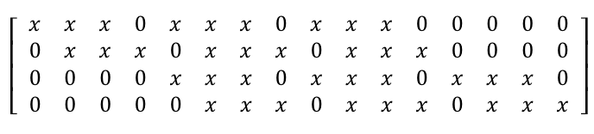







Image Segmentation – Upsampling
Unpooling: upsampled matrix is sparse → densify by
transpose convolution
Unpooling:
Discrete Convolution: $I ∈ ℝ^{16x16}$ $→F∈ ℝ^{4x4}$
Convolving with $K$
multiplying by sparse matrix $C$
$$K= \left[\begin{matrix}x & x \\ x & x\end{matrix}\right]$$
$$C =$$
Transposed Convolution: $F∈ ℝ^{4x4} → I ∈ ℝ^{16x16}$
with $C^{T}$

Slide 39
Image Segmentation – Architecture
transpose convolutional layer
upsampling layer

Slide 40
Summary
Image Classification
two parts: feature extraction and classification
feature extraction based on translation invariance
Image Segmentation
inherent tension between feature extraction and
pixel-wise classification
redesign ConvNets for Classification
In general
Tailoring network to learning problem improves performance

Slide 41
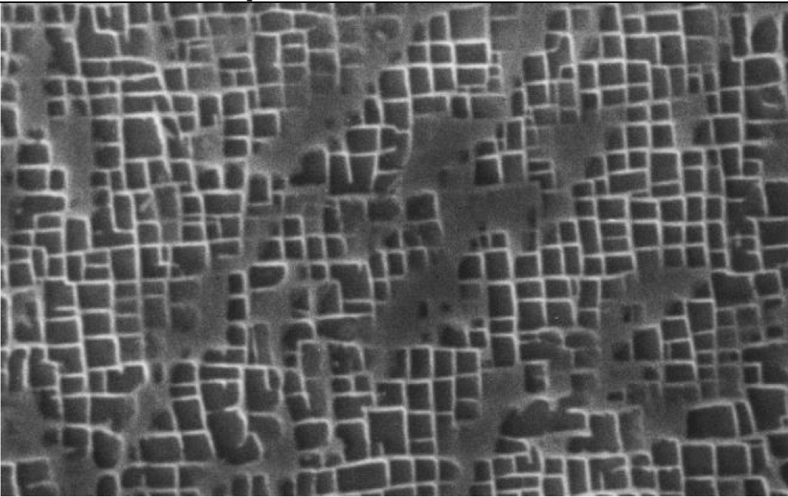
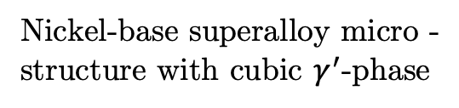
What’s coming next?
Is image segmentation based on Deep Learning applicable to determine different phenotypical structures of a material with nearly human-like precision?
Nickel-base superalloy micro -
structure with cubic $γ^{′}$-phase

