Slide 1
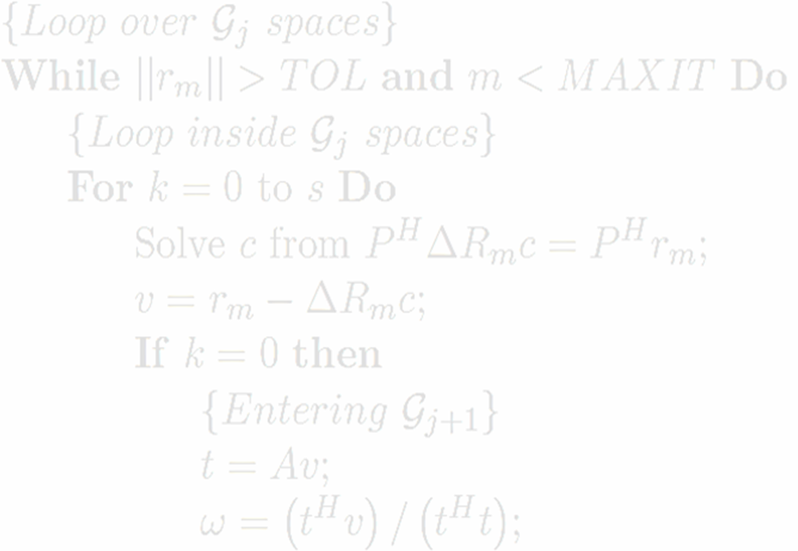
IDR($s$) as a projection method
Marijn Bartel Schreuders
Supervisor: Dr. Ir. M.B. Van Gijzen Date: Monday, 24 February 2014

Slide 2
Overview of this presentation
Iterative methods
Projection methods
Krylov subspace methods
Eigenvalue problems
Linear systems of equations
The IDR($s$) method
General idea behind the IDR($s$) method
Numerical examples
Ritz-IDR
Research Goals

Slide 3
Iterative methods
Consider a linear system
$Ax=b$ (1)
with $A∈ ℝ^{n×n}$ and $b∈ℝ^{n}$
Find an approximate solution $x_{m}$ to (1), with initial guess $x_{0}$
Residual $r_{m}=b−Ax_{m}$

Slide 4
Projection methods Subspaces
Define$𝒦_{m}⊂ ℝ^{n×n}$ of dimension $m≤n$
‘Subspace of candidate approximants’ or ‘Search subspace’
Define$ℒ_{m}⊂ ℝ^{n×n}$ of dimension $m≤n$
‘Subspace of constraints’ or ‘Left subspace’

Slide 5
Projection methods Definition
Find $x_{m}∈{x_{0} + 𝒦}_{m}$ such that $r_{m}⊥ ℒ_{m}$
Find $x_{m}∈{x_{0}+𝒦}_{m}$
Let $V_{m}=\left[v_{1}, v_{2}, …,v_{m}\right]$ form an orthonormal basis for $𝒦_{m}$
Then $x_{m}={ x}_{0} + \sum_{j=1}^{m}{{ y}_{m,j}{ v}_{j} }$
$= x_{0}+ V_{m}y_{m}$
How to find this vector?

Slide 6
Projection methods How to find $y_{m}$
Let $W_{m}=\left[w_{1}, w_{2}, …,w_{m}\right]$ form an orthonormal basis for $ℒ_{m}$
$r_{m} =b−Ax_{m}$
$=b−A\left(x_{0}+V_{m}y_{m}\right)$
$=r_{0} −AV_{m}y_{m}$
$W_{m}^{T}r_{m}=0$
Hence: $W_{m}^{T}r_{0}={(W}_{m}^{T}AV_{m})y_{m} → y_{m}={\left(W_{m}^{T}{AV}_{m}\right)}^{−1}W_{m}^{T}r_{0}$
$$x_{m}=x_{0}+V_{m}y_{m}$$

Slide 7
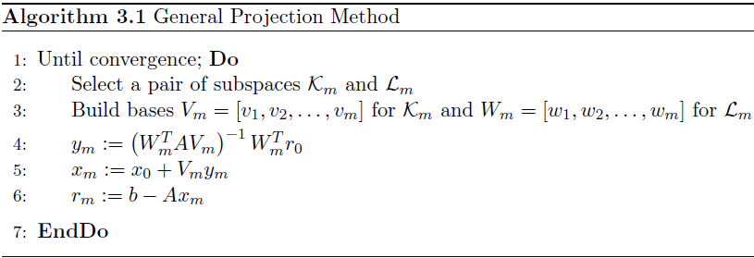
Projection methods General algorithm
How to choose the subspaces?

Slide 8
Krylov subspace methods General
$𝒦_{m}\left(A,v_{1}\right)=span\left(v_{1}, Av_{1}, A^{2}v_{1}, … , { A}^{m−1}v_{1} \right)$
Different methods for different choices of $ℒ_{m}$
Can be used for
eigenvalue problems
linear systems of equations

Slide 9
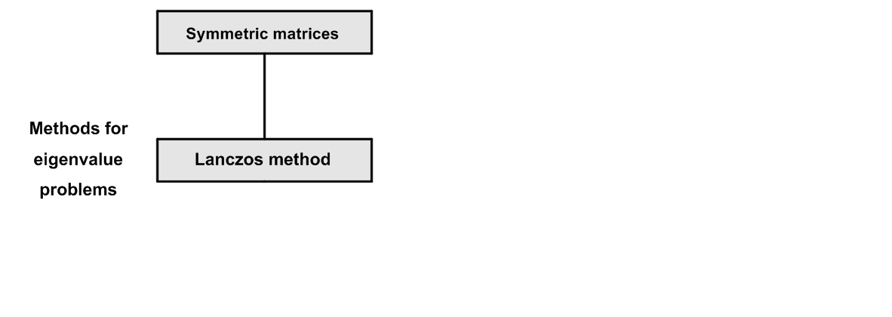
Krylov subspace methods Overview

Slide 10
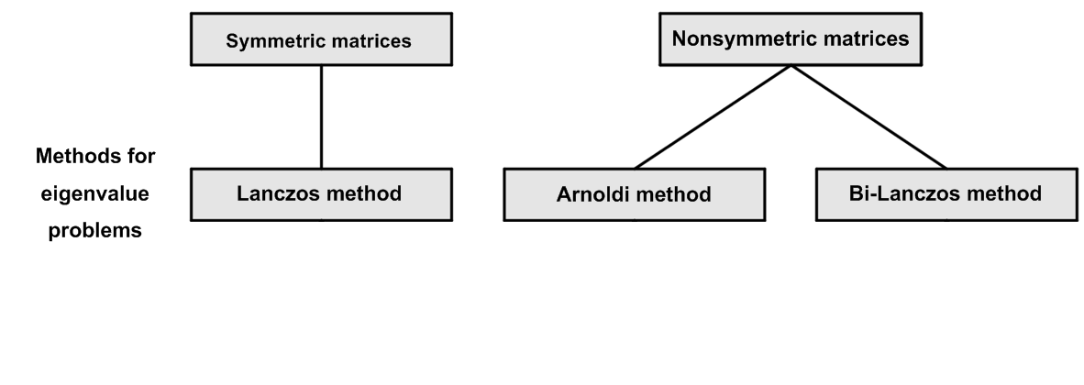
Krylov subspace methods Overview

Slide 11
Krylov subspace methods Eigenvalue problems
Computing all eigenvalues can be costly
A is a full matrix
A is large
Idea: find smaller matrix for which it is easy to compute ‘Ritz values’
Good approximations to some of the eigenvalues of A

Slide 12
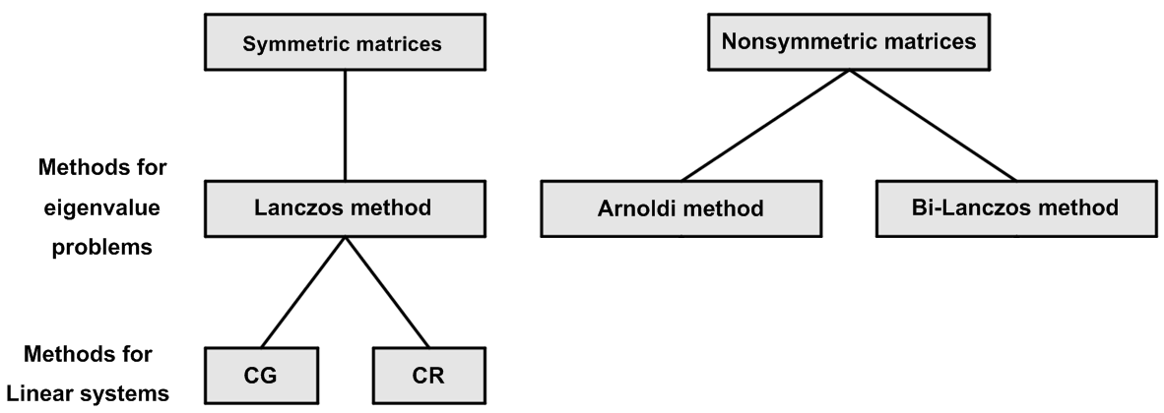
Krylov subspace methods Overview

Slide 13
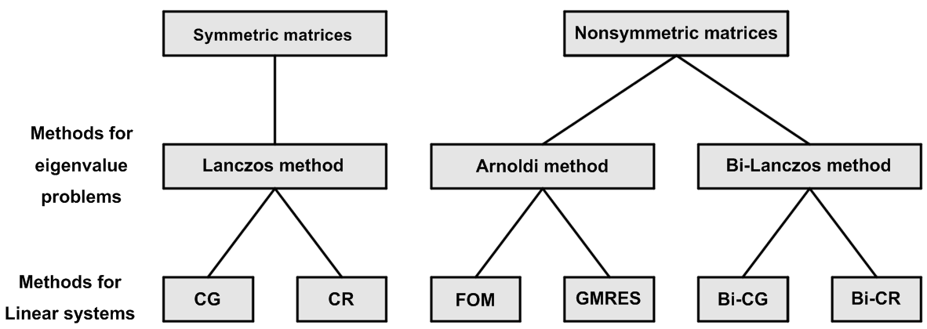
Krylov subspace methods Overview

Slide 14
Krylov subspace methods Symmetric matrices
Conjugate Gradient method (CG)
Optimality condition
Uses short recurrences
Minimises the residual

Slide 15
Krylov subspace methods Nonsymmetric matrices
GMRES-type methods
Long recurrences
Minimisation of the residual
Bi-CG – type methods
Short recurrences
No minimisation of the residual
Two matrix-vector operations per iteration
Are their any other possibilities?

Slide 16
Induced Dimension Reduction (s)
Residuals are forced to be in certain subspaces
Compute $s$ residuals in each iteration

Slide 17
Induced Dimension Reduction (s) IDR theorem
Theorem 1 (IDR theorem):
Let $A∈ℝ^{n×n}$ and $v_{0}∈ℝ^{n}$
Let $𝒢_{0}=𝒦_{n}\left(A,v_{0}\right)$
Let $𝒮⊂ℝ^{n}$ such that $𝒮$ and $𝒢_{0}$ do not share a subspace of $A$
Define: $𝒢_{j}=(I−ω_{j}A)(𝒢_{j−1}∩ 𝒮$)
Then the following holds:
(i) $𝒢_{j+1}⊂𝒢_{j} ∀j≥0$
(ii) $𝒢_{j}=\{0\}$ for some $j<n$

Slide 18
Induced Dimension Reduction (s) Numerical experiments
Convection diffusion equation: $L\left(u\right)= −Δu+β∇u$
Discretise using finite differences on unit cube; Dirichlet boundary conditions
$20$ internal points $→$ $8000$ equations
Stopping criterion: $\left\|r_{j}\right\|<\left\|b\right\|∙{10}^{−8}$

Slide 19
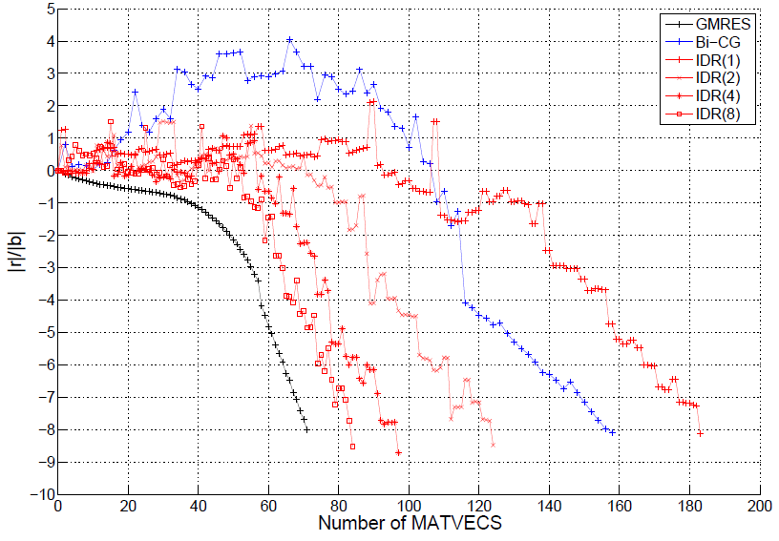
Induced Dimension Reduction (s) Numerical experiments
This is an example of a slide

Slide 20
Induced Dimension Reduction (s) Numerical experiments
Matrix Market: $add20$ matrix
Real, nonsymmetric, sparse $2395×2395$ matrix
http://math.nist.gov/MatrixMarket/data/misc/hamm/add20.html

Slide 21
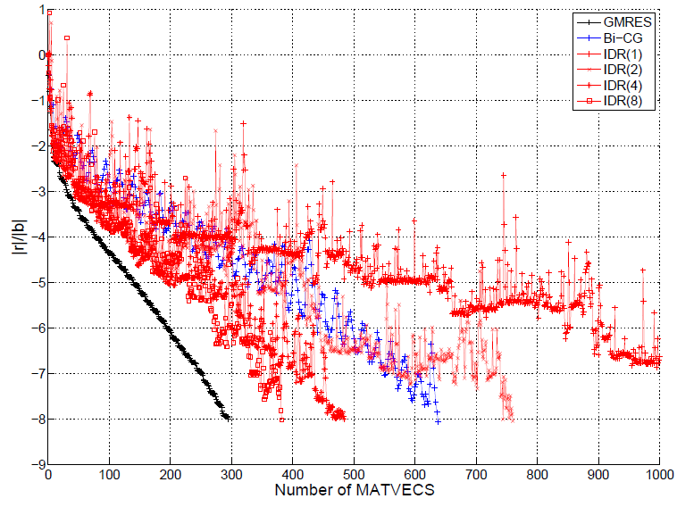
Induced Dimension Reduction (s) Numerical experiments
This is an example of a slide

Slide 22
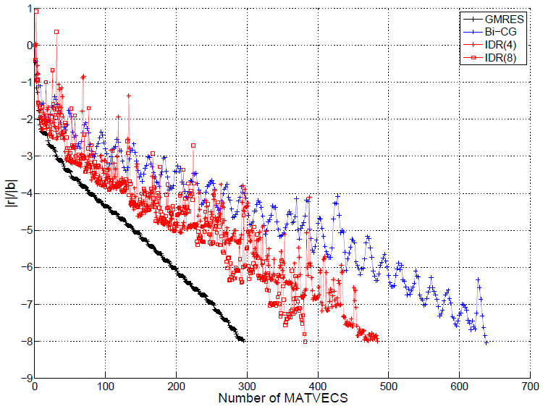
Induced Dimension Reduction (s) Numerical experiments
This is an example of a slide

Slide 23
Induced Dimension Reduction (s) How to choose $ω_{j}$
Recall: $𝒢_{j}=(I−ω_{j}A)(𝒢_{j−1}∩ 𝒮$)
Minimisation of the residuals
Random?
…… ?
How to choose $ω_{j}$?

Slide 24
Induced Dimension Reduction (s) Ritz-IDR
Valeria Simoncini & Daniel Szyld
Ritz-IDR
Calculates Ritz values $θ_{j}$
$ω_{j}=\frac{1}{θ_{j}}$

Slide 25
Research goals
Research goals are twofold:
Make clear how we can see IDR($s$) in the framework of projection methods
Use the IDR(s) algorithm for calculating the $ω_{j}^{′}s$

Slide 26
IDR($s$) as a projection method
Marijn Bartel Schreuders
Supervisor: Dr. Ir. M.B. Van Gijzen Date: Monday, 24 February 2014

Slide 28
Research goals
$\left\|r_{m}\right\|=\left\|v_{n}−ω_{j}Av_{n}\right\|$ Let $Av_{n}=t_{n}$
$=\left\|v_{n}−ω_{j}t_{n}\right\|$
$={\left(v_{n}−ω_{j}t_{n}\right)}^{T}\left(v_{n}−ω_{j}t_{n}\right)$
$=v_{n}^{T}v_{n}−2ω_{j}t_{n}^{T}v_{n}+ω_{j}^{2}t_{n}^{T}t_{n}$
This is a polynomial in $ω_{j}$
To minimise, take derivative w.r.t. $ω_{j}$

Slide 29
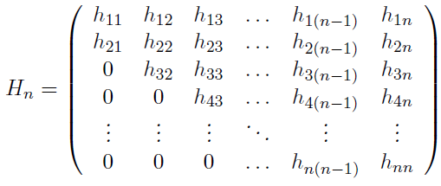
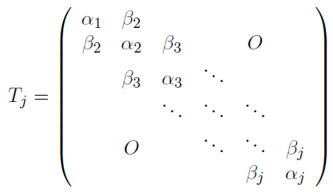
Krylov subspace methods Eigenvalue problems
Arnoldi Method
Lanczos method
&
Bi-Lanczos method

