Slide 1
Physics-Informed Neural Networks
A new approach to the solution of Partial Differential Equations.
Fernando Wangüemert Guerra
MSc. Applied Mathematics (COSSE)

Slide 2
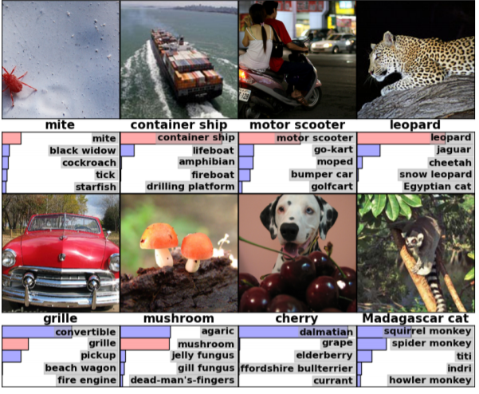
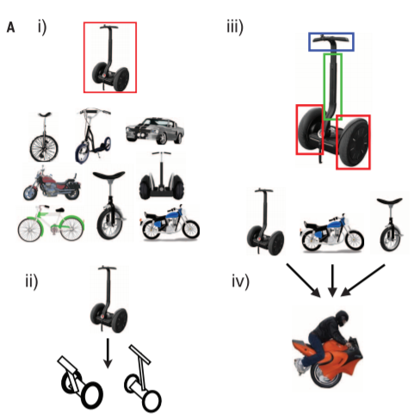
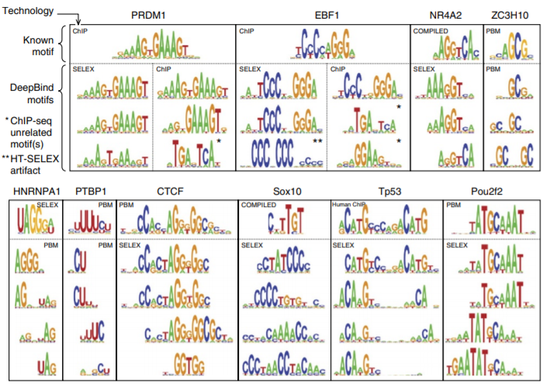
Introduction
Advances in machine learning and data analytics
Image Recognition
Cognitive Science
Genomics

Slide 3
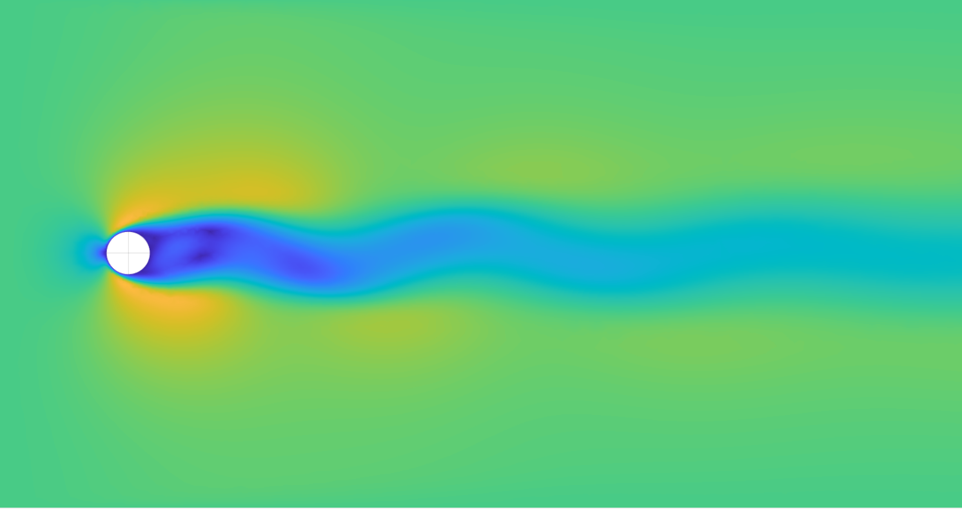
Introduction
Analyzing complex biological or engineering systems
Data scarcity
Obtained via experiments or Numerical simulations through standard methods
We need to work in a small data regime
FEM Simulation 2D Vortex shedding
GOAL : Take advantage of the adaptability of NN to perfom these physical simulations in different scenarios bypassing the data scarcity

Slide 4
Introduction
We use NN as universal function approximators
$$u=f\left(x,t\right)$$
Exploiting Automatic differentiation
INPUT Variables
$$\vec{x},t$$
Trainable Variables
(Weights and biases)

Slide 5
Problem setup
Let’s consider non-linear PDE of the following form:
We define
$f\left(x,t\right)≔u_{t}+ 𝒩\left[u\right],$
and proceed to approximate $u$ by a Deep neural network.
$f\left(x,t\right)$ Will be satisfied through the Loss function

Slide 6
Algorithm, PINN approach
TRAINING
INPUT
Boundary points
Enforce BC
Two sets of points
Collocation points
Enforce physical law
Output

Slide 7
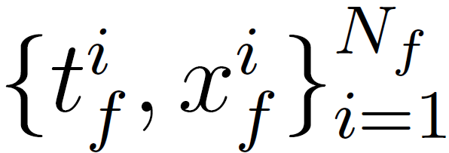
Algorithm, Loss Function
Boundary Data
Collocation points
Optimized by:
Adam (mini Batch)
L-BFGS

Slide 8
Algorithm, Loss Function
$$σ$$
$$σ$$
$$\frac{∂u}{∂x}$$
x
$$σ$$
$$σ$$
$$\frac{∂u}{∂t}$$
$$u$$
$$f(x,t)$$
t
$$σ$$
$$σ$$
$$\frac{∂^{2}u}{∂x^{2}}$$
$$σ$$
$$σ$$
…
…

Slide 9
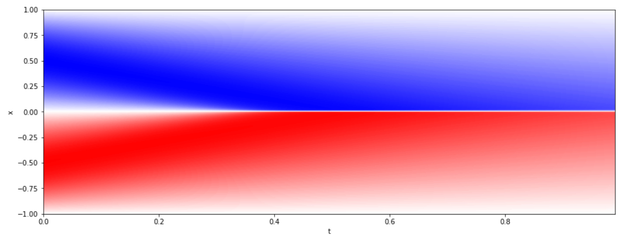
Examples : Burgers Equation

Slide 10
Parameter study
Thorough analysis on the PINNs characteristics with respect to the different parameters:
Number of collocation points
Distribution of the collocation points
Number of layers of the network
NPL of the network
The number of boundary points considered in the PINN (training points) has not been considered in this parameter study

Slide 11
Parameter study / Previous considerations
Curse of dimensionality:
There is an exponential increase in volume associated with adding extra dimensions to a mathematical space.
For example, 100 evenly spaced sample points suffice to sample a unit interval (a "1-dimensional cube") with no more than 0,01 distance between points
An equivalent sampling of a 2-dimensional unit cube with a lattice that has a spacing of ${10}^{−2}= 0,01$between adjacent points would require ${100}^{2}$sample points.

Slide 12
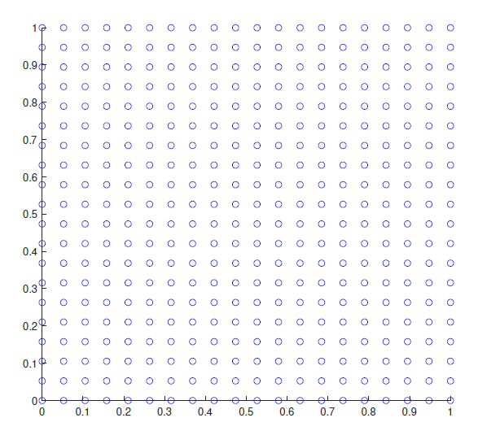
Parameter study / Previous Considerations
Applying this criteria, if we have a certain number N of collocation points distributed over a 2D square domain of side length L, one can state that, in order to have a dimensionally congruent number of training points located in the boundary, the number of these boundary points must be $\sqrt{N}$.
In any case, the effect that these extra points have in the optimization time is considered to be negligible.
This dimensionality evolution deeply affects the size of the domain for multi dimensional input problems

Slide 13
Error characterization on PINNs
The approximation error, measures how closely $u_{F}$ can approximate u.
The generalization error is determined by the number and location of collocation points in the domain.
Neural networks of larger size may have smaller approximation error but could lead to higher generalization errors, that could leads to difficulties in convergence.
Finally, the optimization error stems from the loss function complexity and the optimization setup, such as learning rate and number of iterations (Final Loss value is not zero).

Slide 14
Parameter study
Thorough analysis on the PINNs characteristics; the evaluation (output) values obtained are:
Evolution of the loss value
Final Loss Value (stagnation)
Final L_2 error Value
Error evolution (stagnation)
Error distribution
Optimization time
Loss distribution

Slide 15
Parameter Study Procedure
First step ; Lower bound on the error
Knowledge on the prior information
Testing the network capabilities
Network Inputs

Slide 16
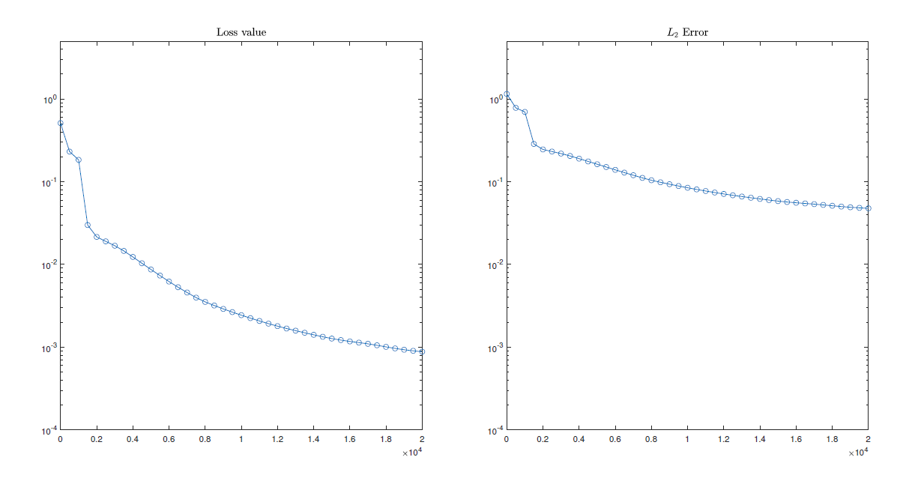
Parameter study
Loss and error evolution with respect to the number of iterations.
Every 400 iterations both the loss function and the error are evaluated

Slide 17
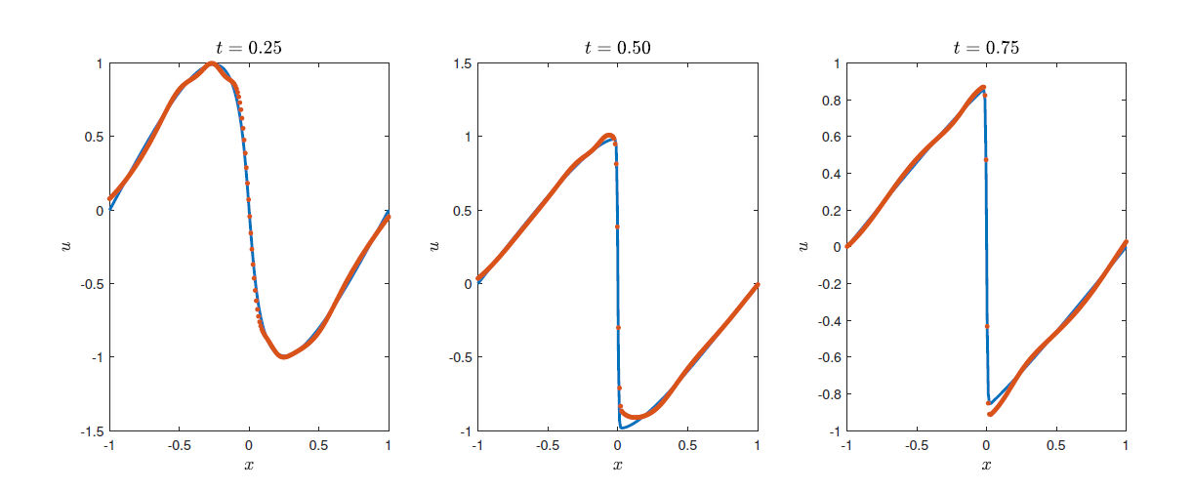
Parameter study
Final prediction

Slide 18
Case study 1
The first case study is carried out with the following input parameters.
Why this first set up?

Slide 19
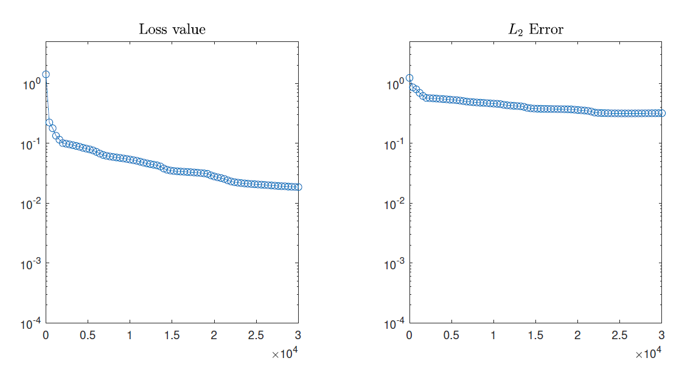
Case study 1

Slide 20
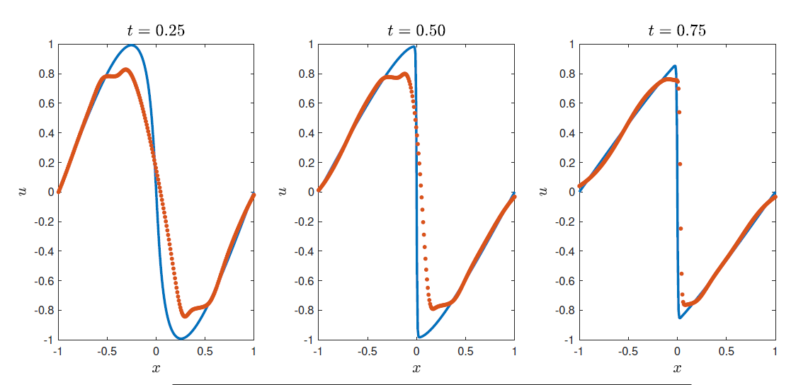
Case study 1
The solution obtained after the optimization process is:

Slide 21
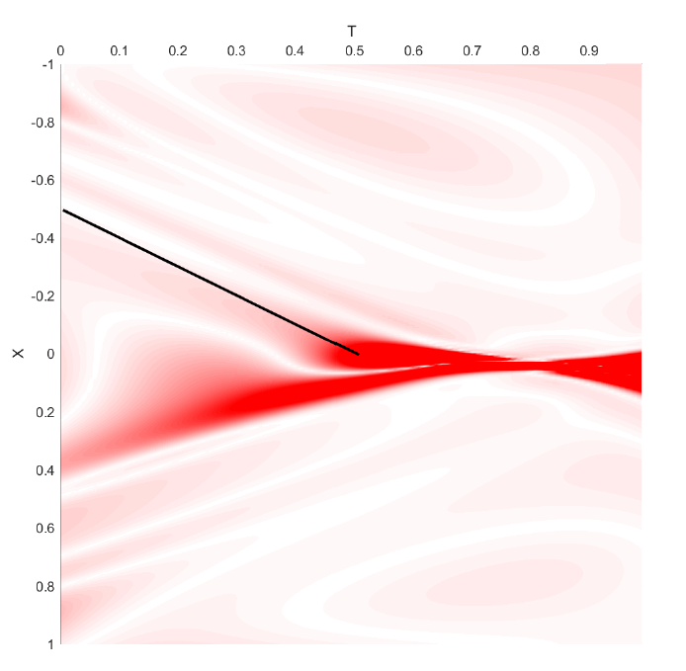
Case study 1
Physics enforcement error
Output parameters of this study case
A very simple network and a small number of collocation points, the NN captures the main aspects of the solution

Slide 22
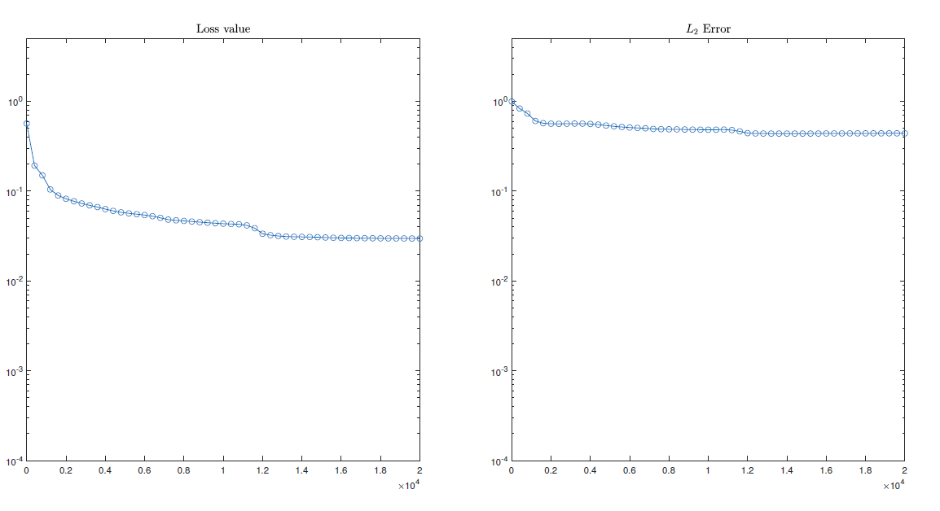
Case study 1
Study with different sizes of the collocation point set
Analogous results in all theses cases

Slide 23
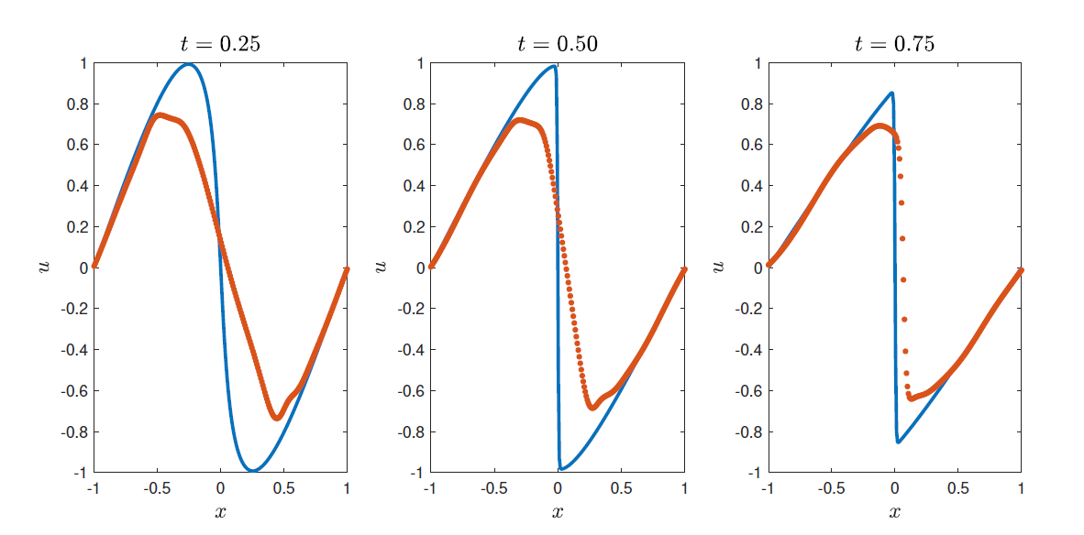
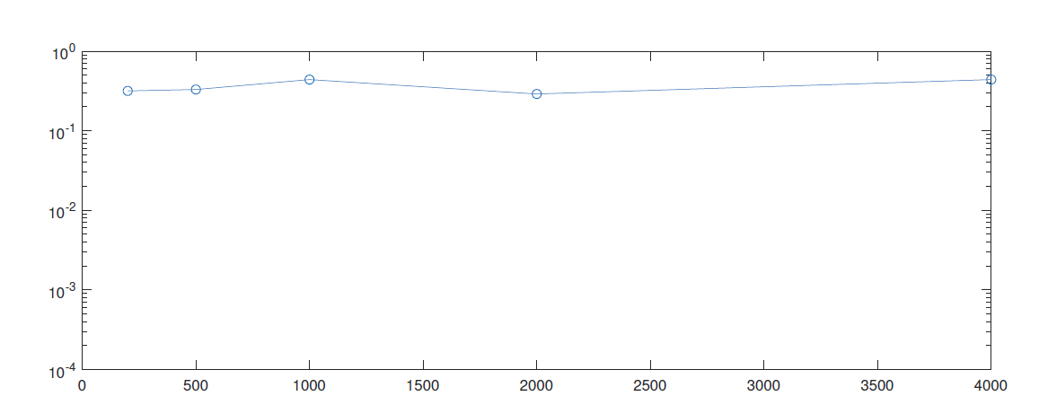
Study Case 1
Random Component in the final results
Not a significant evolution with the collocation points
This is what we anted!

Slide 24
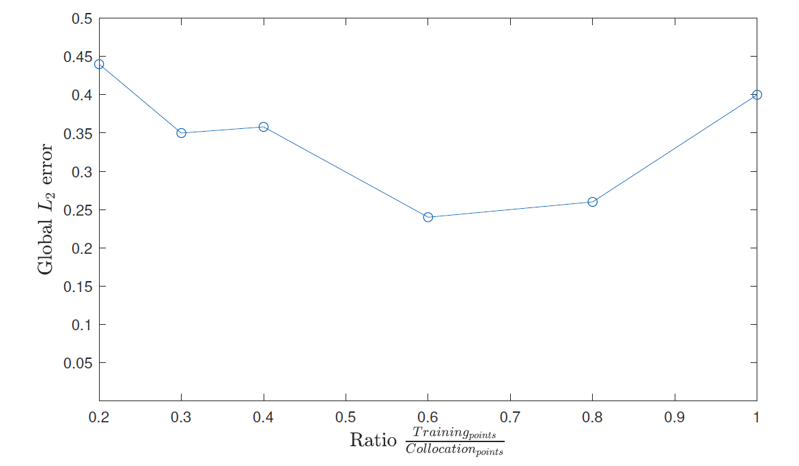
Study Case 1
But first, we need to check a hypothesis:

Slide 25
Case study 2
Increased network complexity
We will compare the behaviour of this network with respect to case study 1
Same Number of collocation points

Slide 26
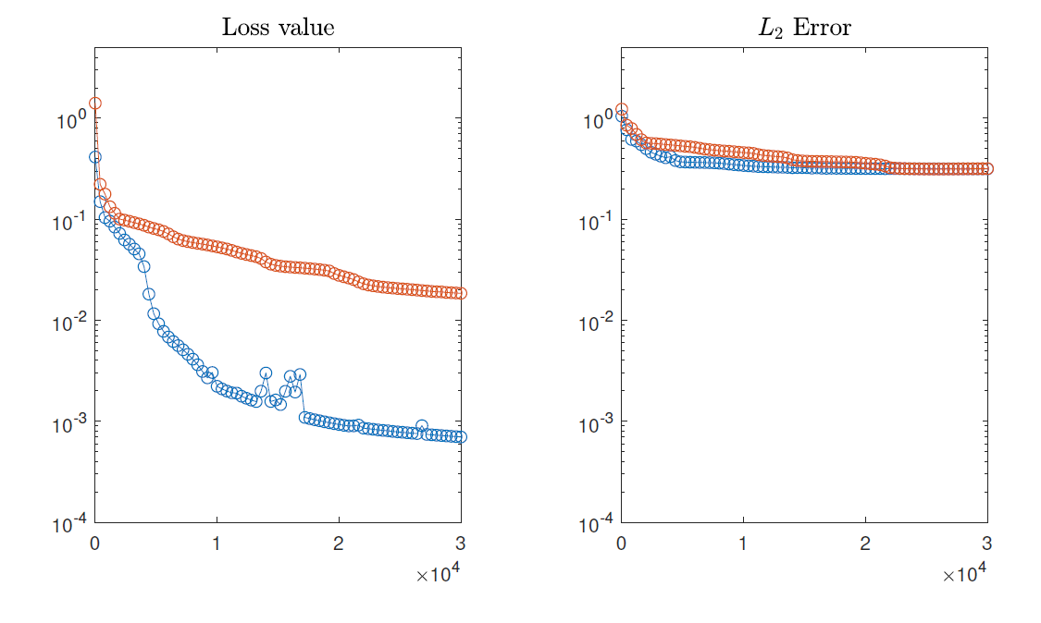
Case study 2
Main observation: Loss function evolution for the different networks
Still substantial mistakes

Slide 27
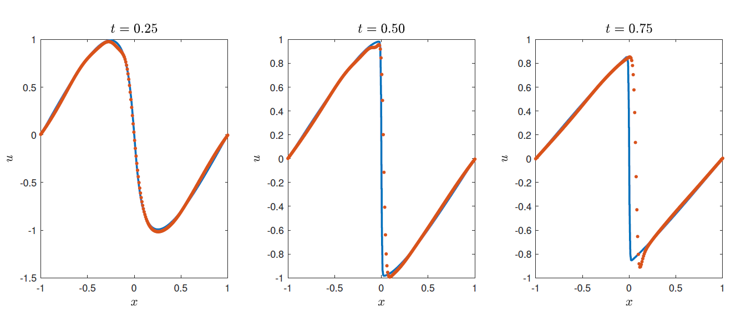
Case study 2 / Results
Next step: Increase the number of collocation points to see whether a behaviour enhancement appears

Slide 28
Case study 2.1 // Increase of the number of collocation points
1000 Collocation points
Objective: Decrease the “difference” between the loss value and the error

Slide 29
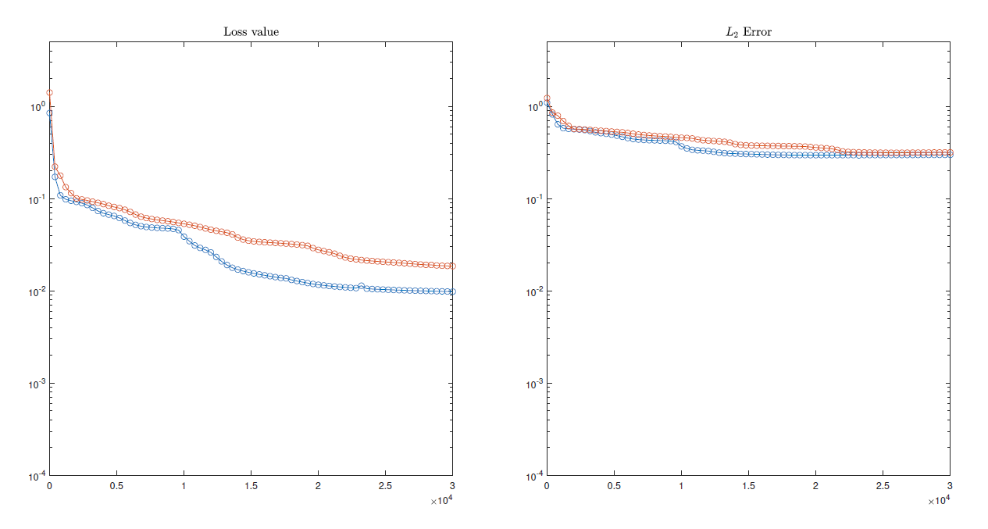
Case study 2.1 // Increase of the number of collocation points
1000 Collocation points
Objective: Decrease the “difference” between the loss value and the error

Slide 30
Case study 2.2 // Increase of the number of collocation points
4000 Collocation points
Objective: Decrease the “difference” between the loss value and the error. Decreasing the L2 error

Slide 31
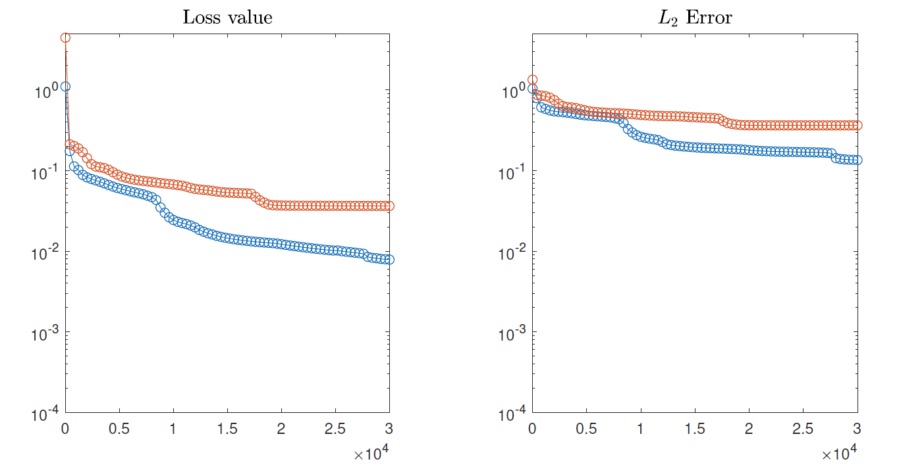
Case study 2.2 // Increase of the number of collocation points
4000 Collocation points
Objective: Decrease the “difference” between the loss value and the error. Decreasing the L2 error

Slide 32
Case study 2.2 // Increase of the number of collocation points
4000 Collocation points
Objective: Decrease the “difference” between the loss value and the error. Decreasing the L2 error

Slide 33
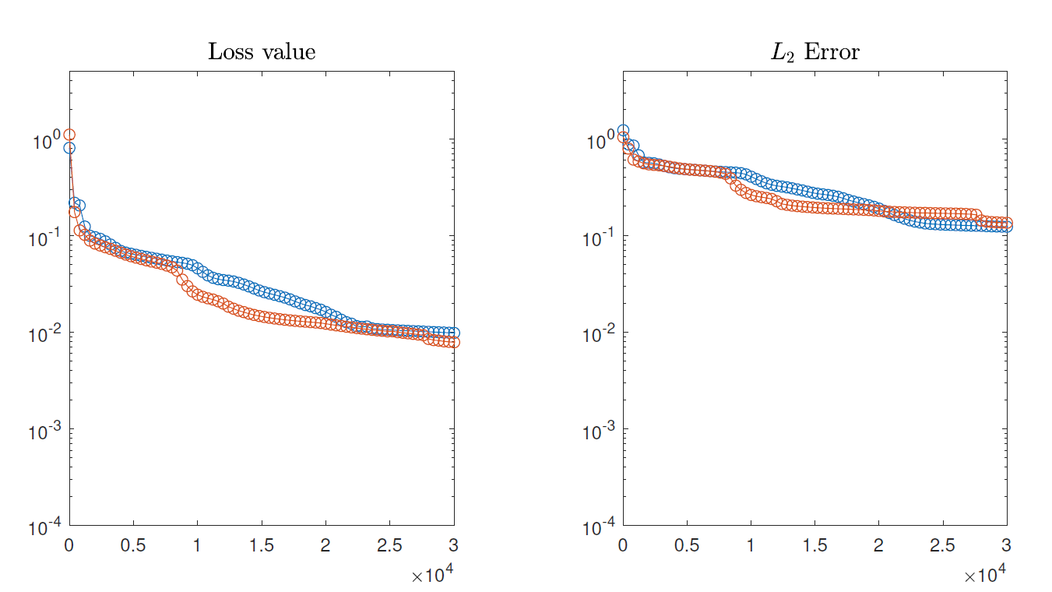
Case study 2.2.1 // Increase of the number of collocation points
8000 Collocation points vs 4000 collocation points
Objective: Determine where the limit is, does the error decrease if we keep increasing the collocation points?
1141 Seconds of optimization time for 8000 collocation points with the current network setup

Slide 34
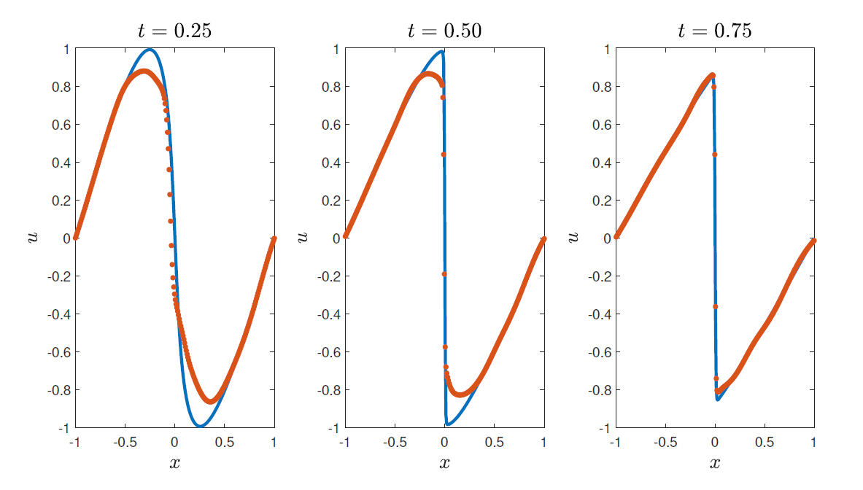
Case study 2.2 // Increase of the number of collocation points
4000 collocation points
Prediction Results

Slide 35
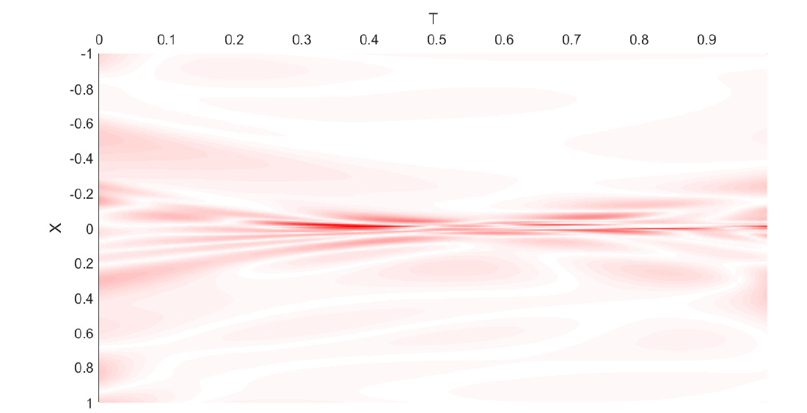
Case study 2.2 // Increase of the number of collocation points
4000 collocation points
Error results ( Domain distribution) Physics error distribution

Slide 36
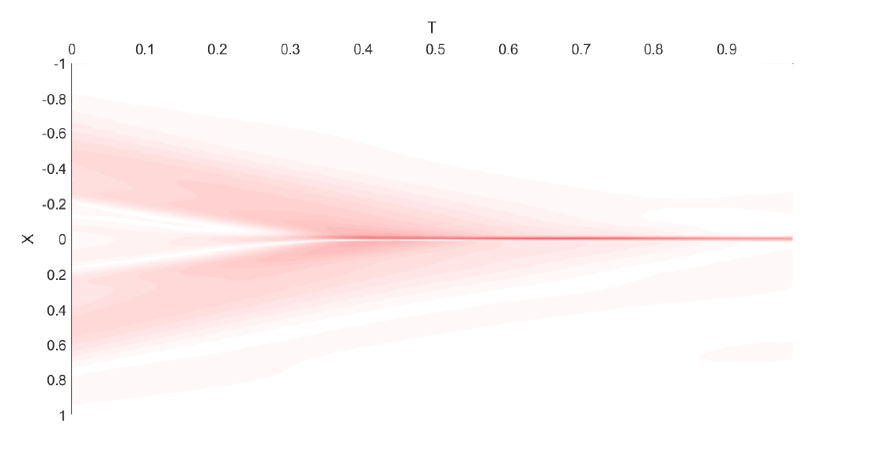
Case study 2.2 // Increase of the number of collocation points
4000 collocation points
Error results ( Domain distribution) Absolute error distribution

Slide 37
Case study 3 // Network Complexity
Study of the effect of an increase in the Network Complexity

Slide 38
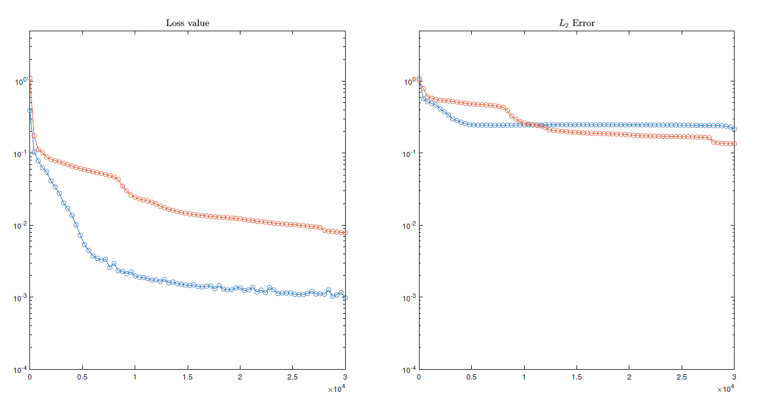
Case study 3 // Network Complexity
Study of the effect of an increase in the Network Complexity

Slide 39
Case study 3 // Network Complexity
Study of the effect of an increase in the Network Complexity

Slide 40
Case study 3 // Network Complexity
Study of the effect of an increase in the Network Complexity
The conclusion that we arrive is that the number of collocation points is again the problem. This is because the excessive network complexity of the set up.

Slide 41
Case study 3 // Network Complexity
Study of the effect of an increase in the Network Complexity
With this set up we arrive to the first significant performance enhancement

Slide 42
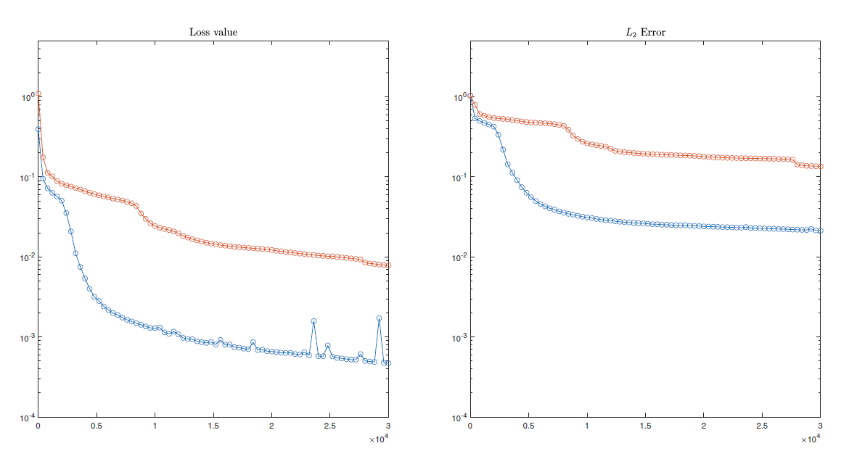
Case study 3 // Network Complexity

Slide 43
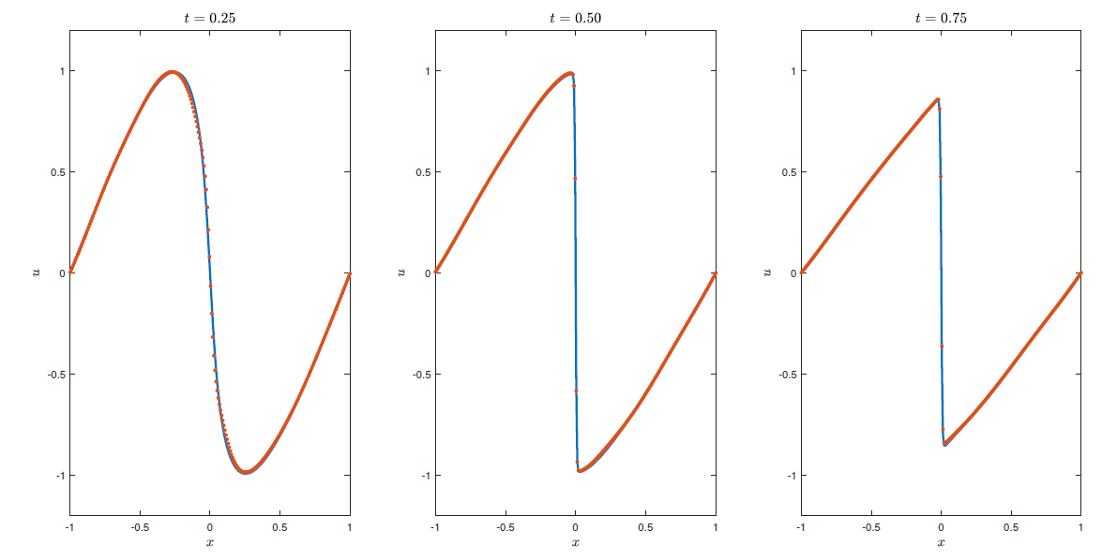
Case study 3 // Network Complexity

Slide 44
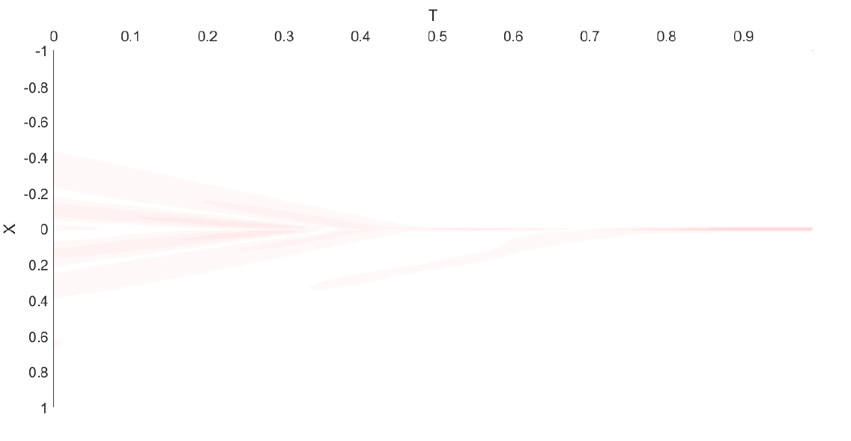
Case study 3 // Network Complexity
Absolute error in the domain (same color axis)

Slide 45
Case study 3 // Network Complexity

Slide 46
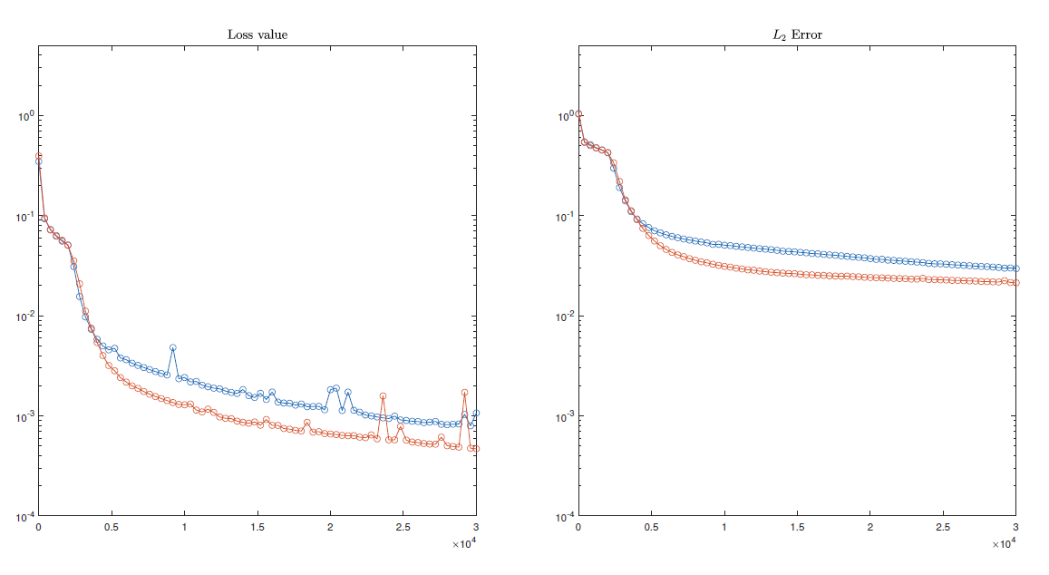
Case study 3 // Network Complexity

Slide 47
Conclusions of this last example
Networks used in literature are much more complex. Infra-utilized
Time utilized due to the increase in the collocation point set.
Network complexity and the number of collocation points must be coordinated/tuned in order not to loose computational time and error capacity. Considerable loses otherwise.

Slide 48
Collocation point refinement
With the working examples seen before, the idea now is to perform a refinement in the collocation points to evaluate whether this improves the capabilities of the PINN.
The report treats two examples with a different number of collocation points. In this presentation only one of them will be treated. Both of them with the same conclusions

Slide 49
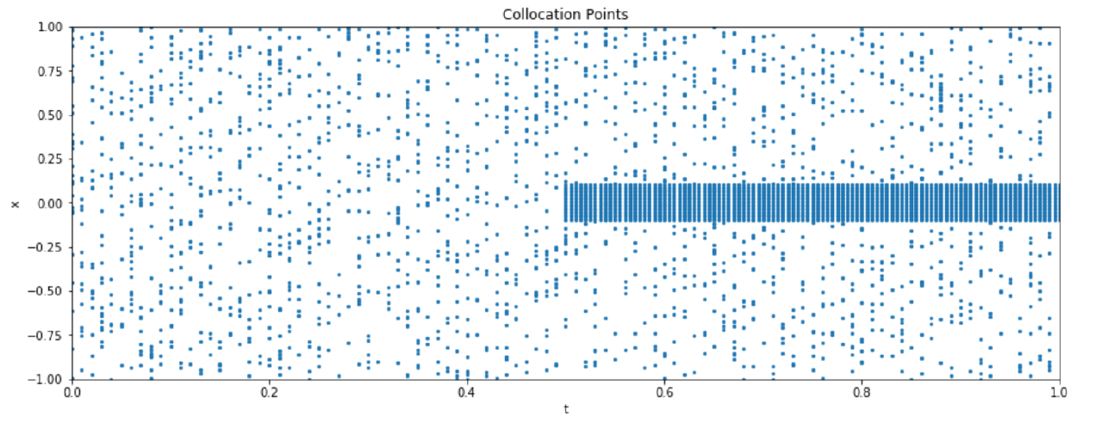
Collocation point refinement
Applied to the previous working example with 4000 collocation points.

Slide 50
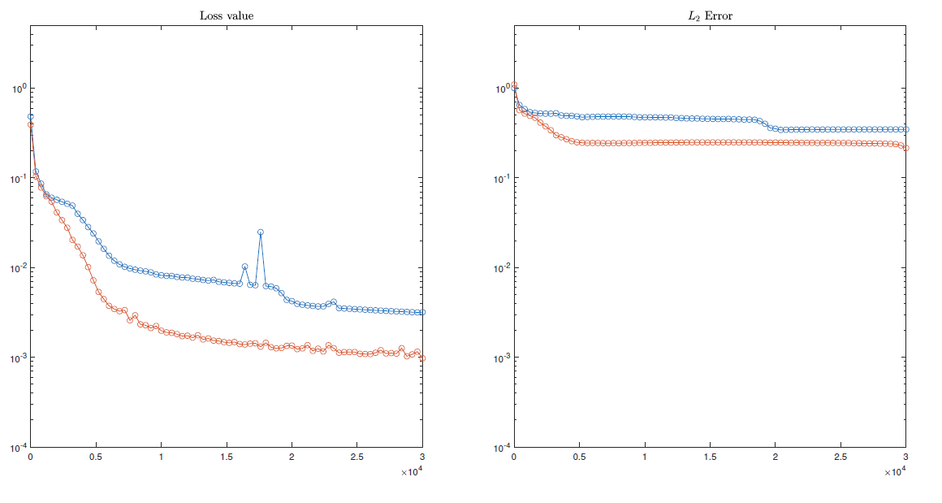
Collocation point refinement
Applied to the previous working example with 4000 collocation points.

Slide 51
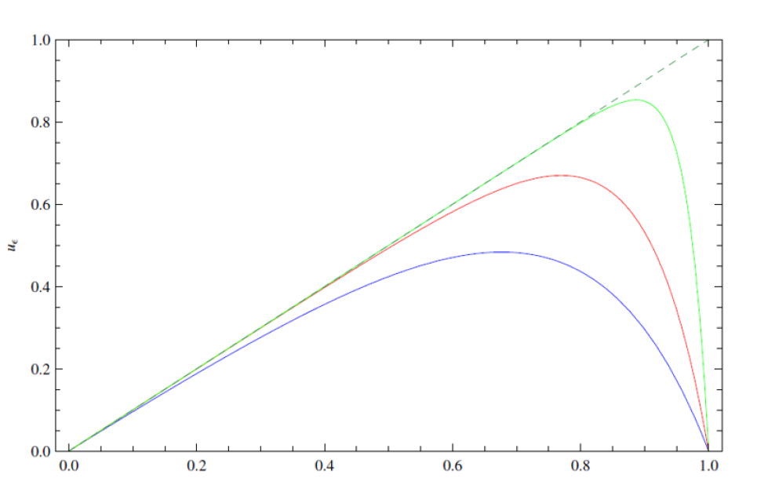
Collocation point refinement / Singularly perturbed problems
Due to the counter intuitive nature of these results, a simpler study case is considered:

Slide 52
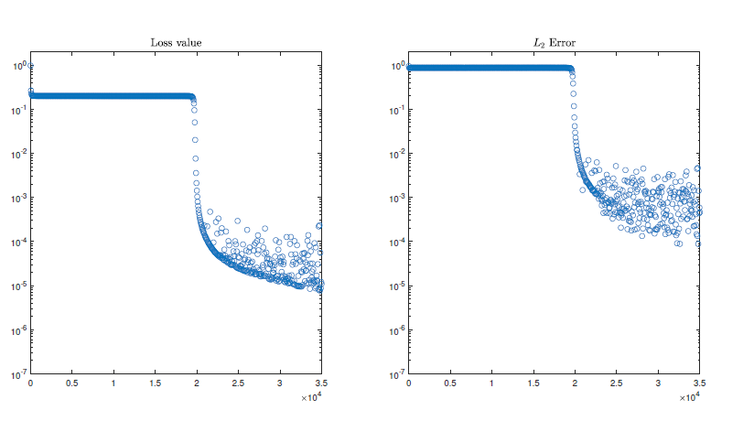
Collocation point refinement / Singularly perturbed problems
Due to the counter intuitive nature of these results, a simpler study case is considered:

Slide 53
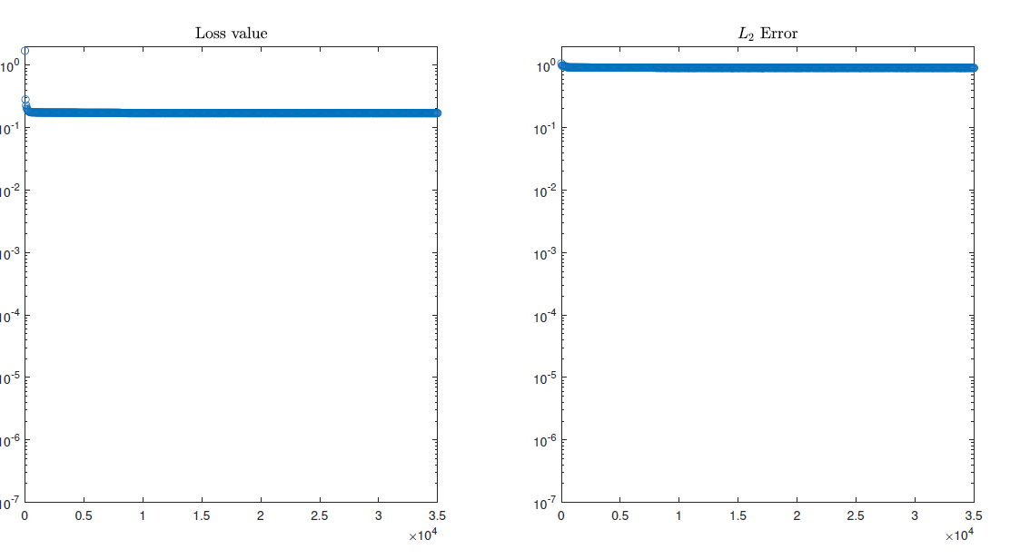
Collocation point refinement / Singularly perturbed problems
Due to the counter intuitive nature of these results, a simpler study case is considered:

Slide 54
Inverse Problems
Data driven discovery of PDEs
Given a small set of scattered and potentially noisy observations of the a hidden state u(x; t),
Which parameters best describe the observed data?

Slide 55
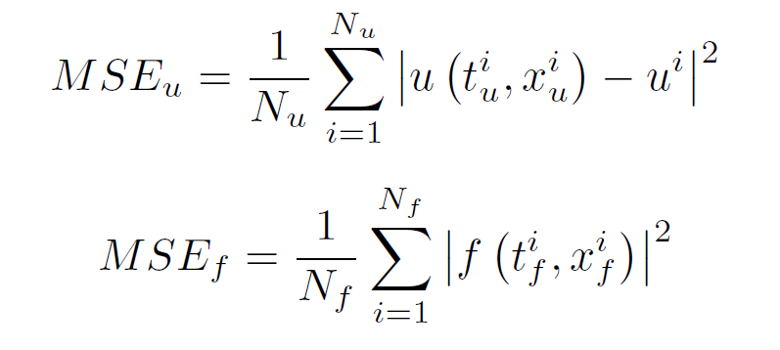
Inverse Problems
Data driven discovery of PDEs
In literature, this $λ$ set is defined as a trainable parameter of the NN. The information obtained is a single (Scalar value)

Slide 56
Inverse Problems / The project approach
$$σ$$
$$σ$$
$$\frac{∂u}{∂x}$$
x
$$σ$$
$$σ$$
$$\frac{∂u}{∂t}$$
$$f(x,t)$$
$$λ$$
t
$$σ$$
$$σ$$
$$u$$
$$\frac{∂^{2}u}{∂x^{2}}$$
$$σ$$
$$σ$$
…
…

Slide 57
Inverse Problems / First case study

Slide 58
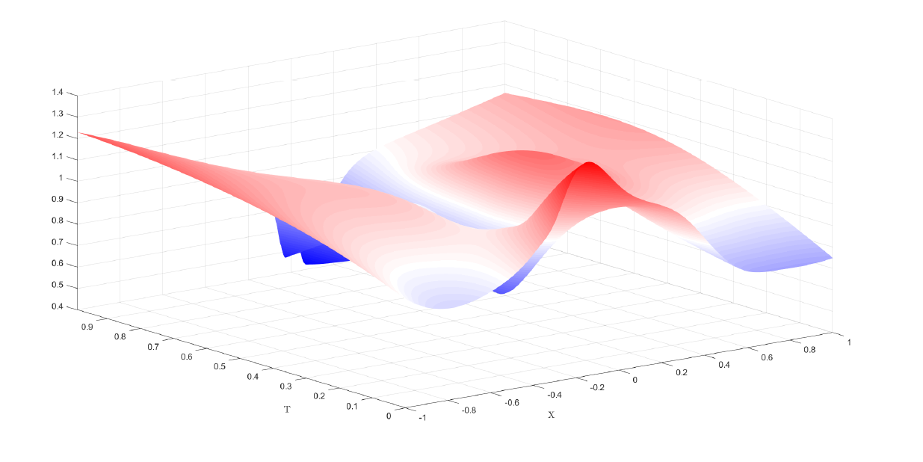
Inverse Problems / First case study

Slide 59
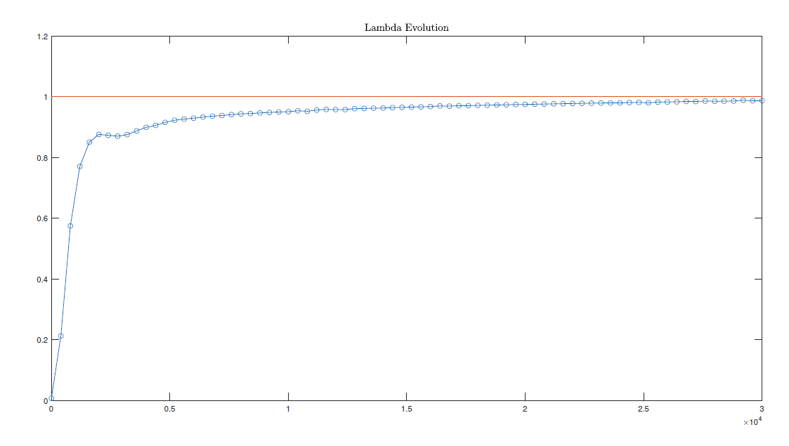
Inverse Problems / First case study

Slide 60
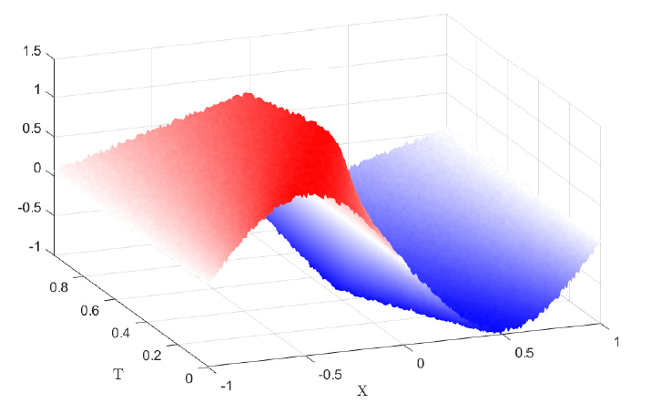
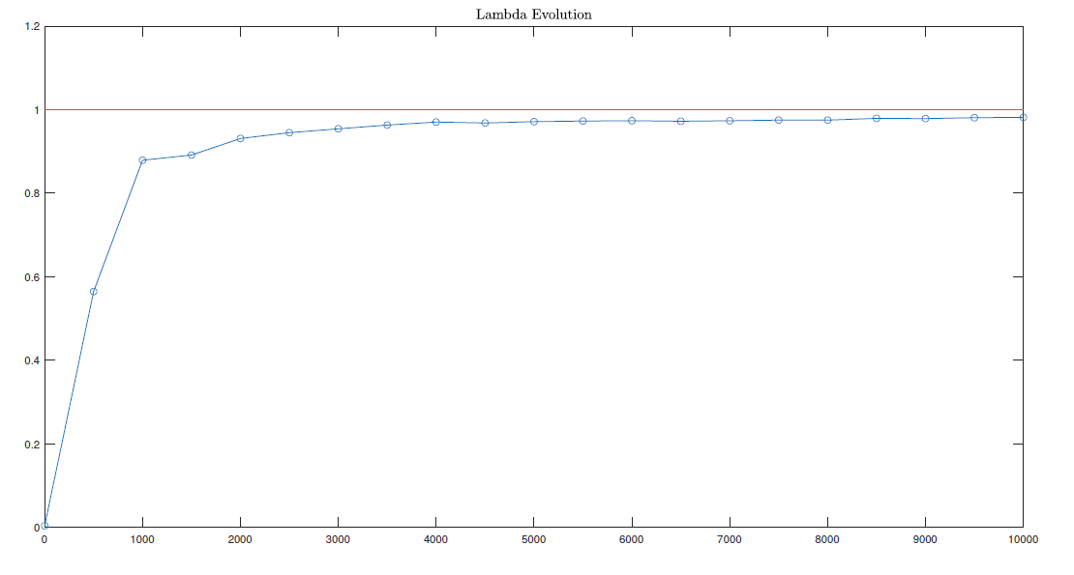
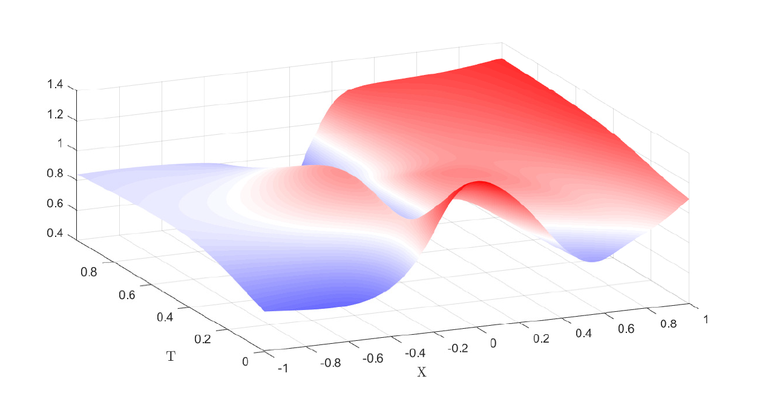
Inverse Problems / Noise Study

Slide 61
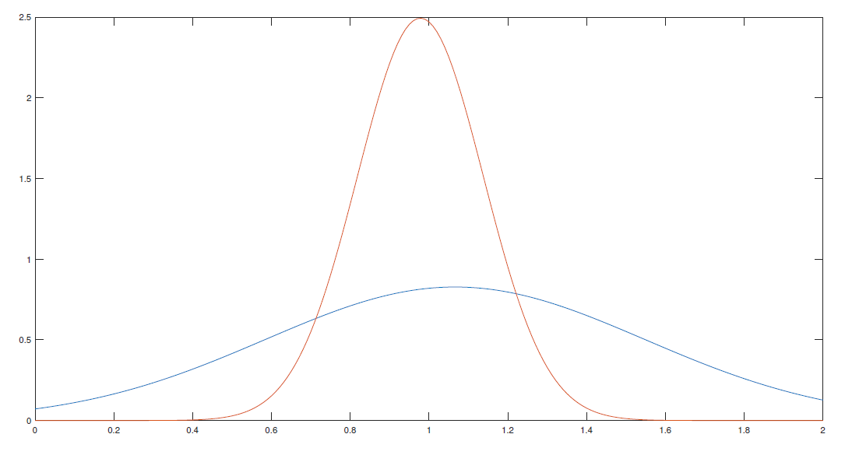
Inverse Problems / Noise Study
Approximation of the $λ$ prediction as a normal distribution with and without noise

Slide 62
Inverse Problems / Difficulties
Mean equal to 0
High accuracy needed

Slide 63
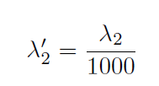
Inverse Problems / Difficulties
High accuracy needed

Slide 64
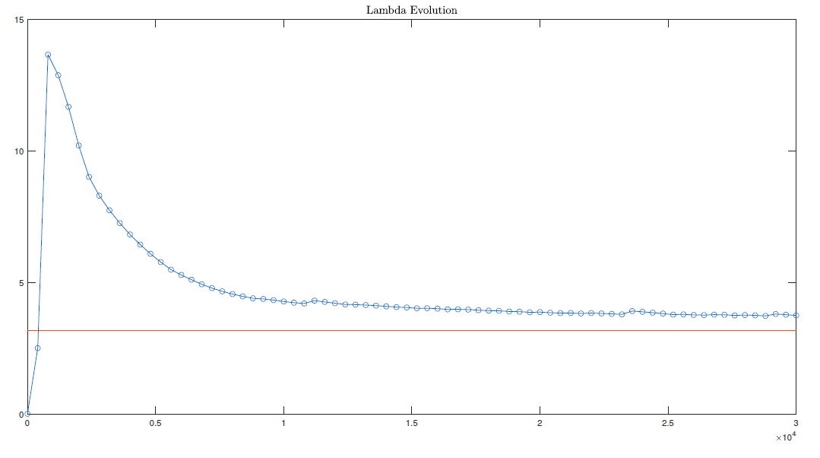
Inverse Problems / Difficulties

Slide 65
Inverse Problems / Difficulties
Mean equal to 0

Slide 66
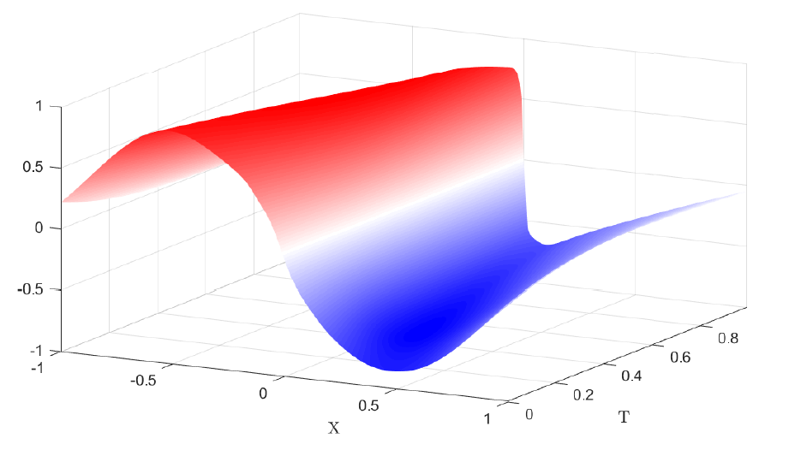
Inverse Problems / Difficulties

Slide 67
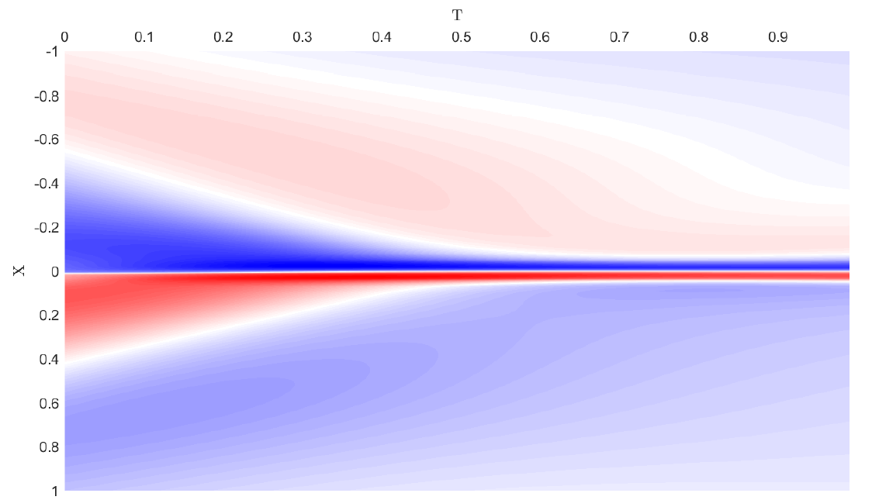
Inverse Problems / Difficulties
$λ$ prediction of the whole convective term

Slide 68
Conclusions
Thorough parameter study
Convergence is not trivial
The error characteristics of PINNS result fundamental to accuratelly predict solutions in manageable times
Valid Framework on the PINNs behaviour
Versatility, inverse problems capabilities
PDE identification

Slide 69
Questions?
Thank you

Slide 70
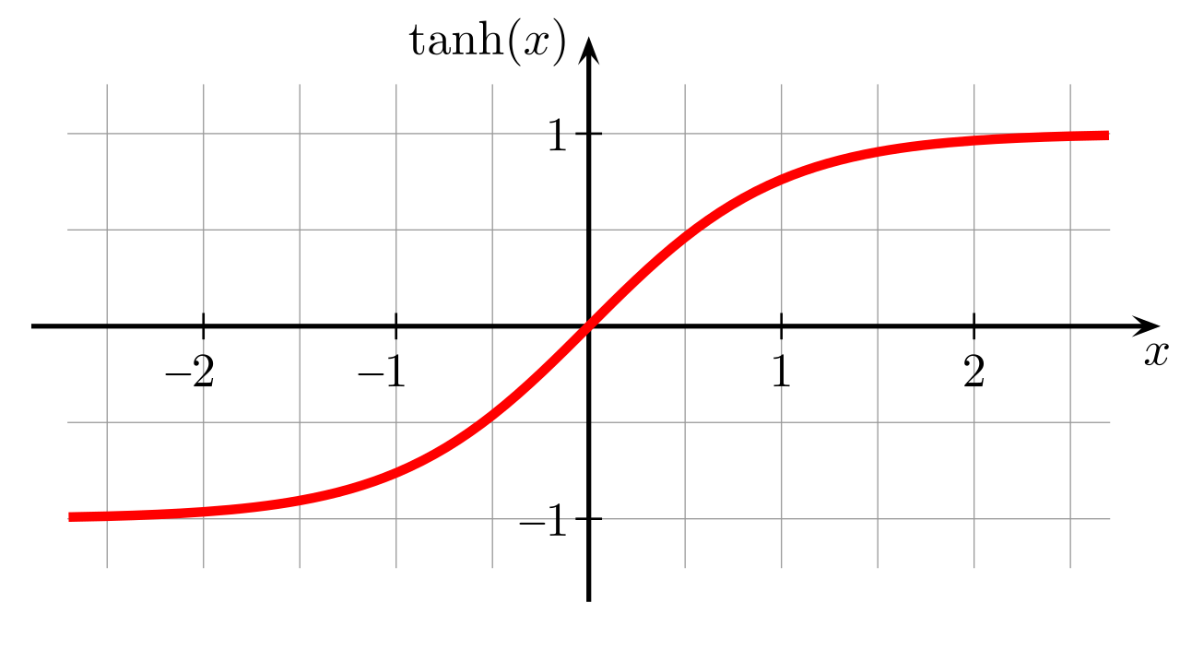
Burgers Equation
Network Characteristics:
4000 Collocation points
100 Training (Boundary) points
5 hidden layers 20 neurons per layer
3000 Iterations Adam optimizer
3000 Iterations L-BFGS
Activation function : $tanh$

Slide 71
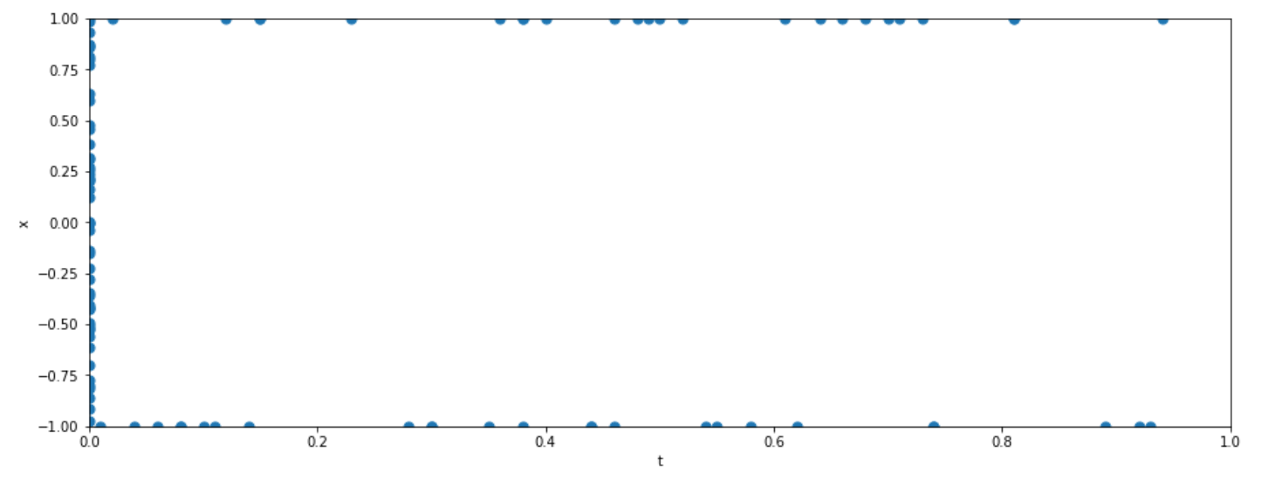
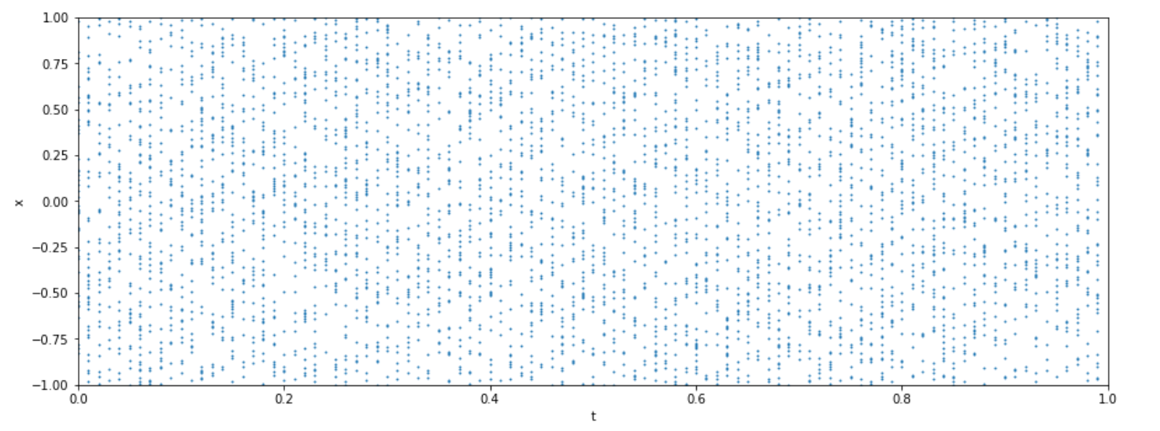

Slide 72
Burgers Equation 1D, Results

Slide 73
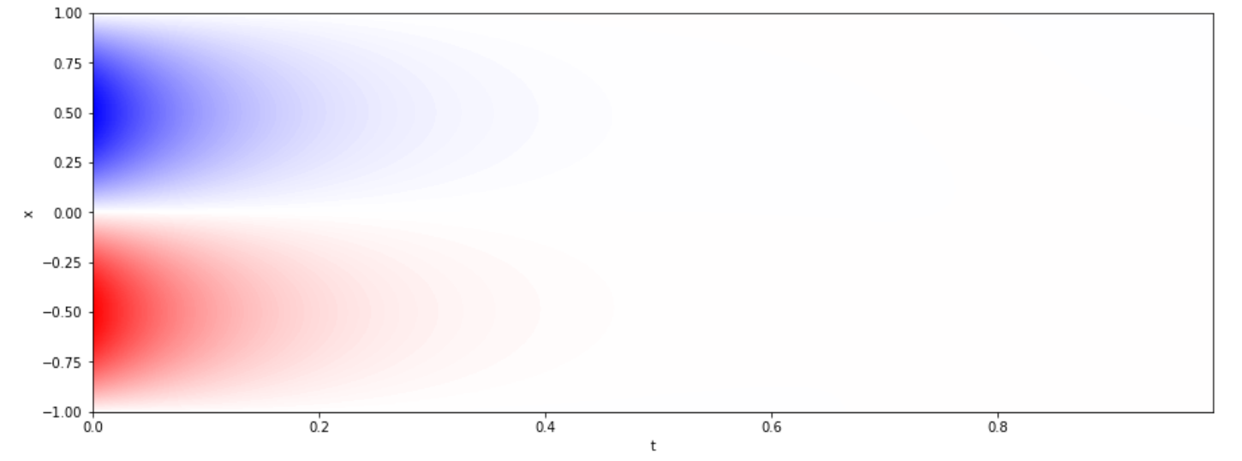
Heat equation 1D, Results
Loss value : $1,10139 x {10}^{−5}$

Slide 74
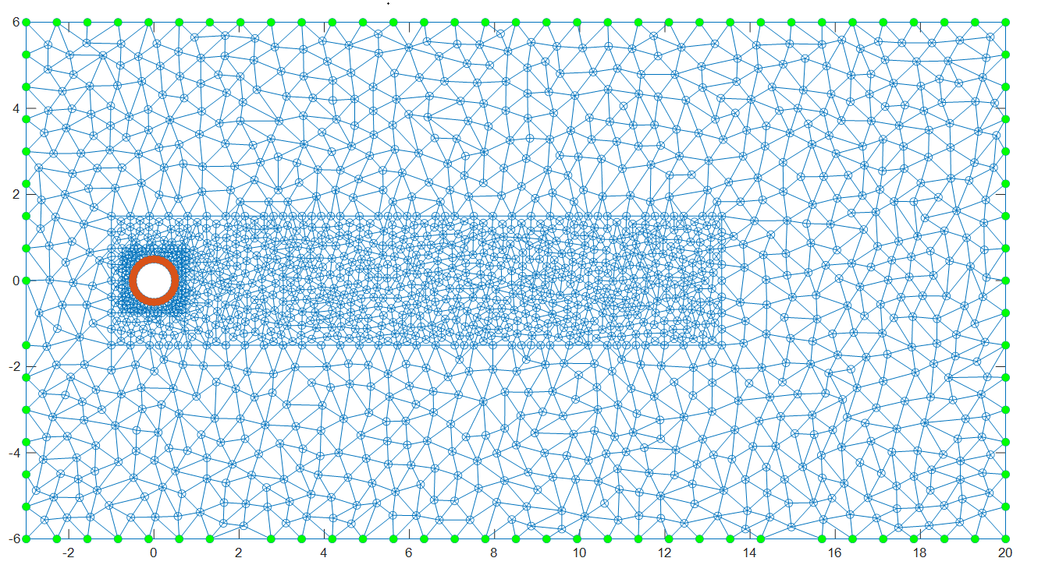
Poisson Equation 2D
$${− u}_{xx} − u_{yy}=0$$
$$u=1$$
$$u=0$$

Slide 75
Poisson Equation 2D

Slide 76
Poisson problem II, Convergence
No theoretical guarantee of convergence
Empirical Experience (Literature) suggests that :
Sufficiently Expressive NN
Well-posed PDE
+
Will lead to convergence
Well, not exactly…

Slide 77
Poisson problem II, Convergence
Initial weights: Glorot normal
$${− u}_{xx} − u_{yy}=−1$$
Same B.C
Loss value : $\sim {10}^{−4}$
Fails to converge after a high number of iterations

Slide 78
Poisson problem II, Convergence
Initial weights: Solution to problem I
$${− u}_{xx} − u_{yy}=−1$$
Same B.C
Loss value : $\sim {10}^{−4}$
Quickly converges after a low number of iterations

Slide 79
Heat Equation 2D
3 inputs
Different network architecture
More Complex
NN
$$σ$$
$$σ$$
Convergence problems worsen
x
$$σ$$
$$σ$$
y
$$u$$
$$σ$$
$$σ$$
t
$$σ$$
$$σ$$
…

Slide 80
Heat Equation 2D
Same B.C as in Poisson
Initial Condition

Slide 81
Heat Equation 2D
Initial weights : Glorot normal

Slide 82
Heat Equation 2D
Instead of initializing with different weights
“Helper” Loss Function
Were $u$ is defined as the Poisson (steady) solution at every time instant

Slide 83
Heat Equation 2D

Slide 84
Questions? Thank you for your time
Playa Blanca, Lanzarote

