Slide 1
Tuning the surface tension in SPH independently of the fluid rheology
Made by:
Kjeld Broekema
Supervisors:
Prof.dr.ir. K. Vuik
Prof.dr.ir. J.T. Padding
Ir. S. Sneijders

Slide 2
Overview
Motivation
Rheology
SPH: Smoothed Particle Hydrodynamics
Tuning methods
Numerical experiments
Research questions
Motivation
Rheology
SPH
Methods
Numerical experiments
Research
questions

Slide 3
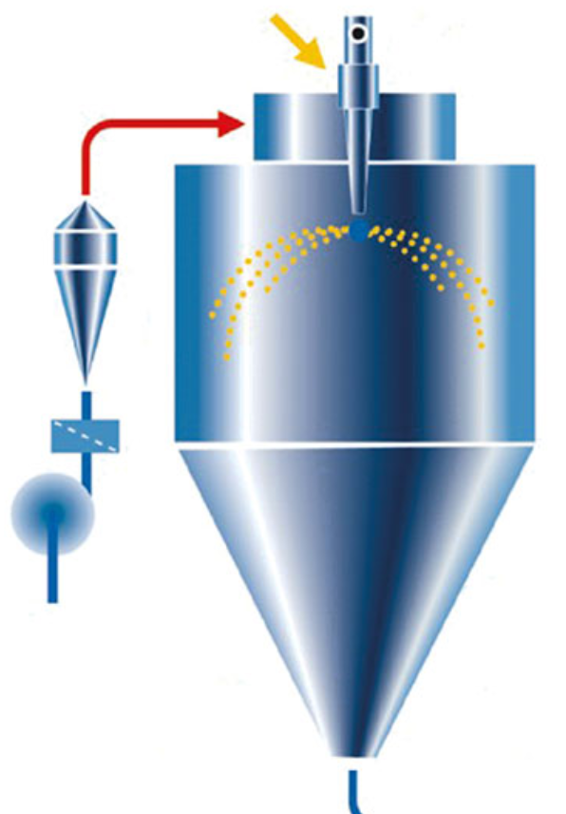
Motivation
Spray drying
food,paint and pharmaceutical
Complex processes
Morphology
density and dissolubility,
Trial-and-error
Numerical simulations
Rheological properties
constitutive equations
Motivation
Rheology
SPH
Methods
Numerical experiments
Research
questions

Slide 4
Motivation
Particle interaction forces (PIF)
Smoothed Particle Hydrodynamics (SPH)
Large deformations
Complex (free) surfaces
Multi-phases
PIF also affects the surface tension
Main research question:
How can particle interaction forces be used to tune the fluid rheology and surface tension independently?
Motivation
Rheology
SPH
Methods
Numerical experiments
Research
questions

Slide 5
Rheology: Navier Stokes equations
Conservation of mass:
$\frac{Dρ}{Dt}=−ρ∇⋅u$
Conservation of momentum (general fluid):
$ρ\frac{Du}{Dt}=− ∇p−∇⋅τ+F_{body}$
Constitutive equation incompressible (viscous) Newtonian fluid:
$τ=−μ\underbrace{[∇u+{(∇u)}^{T}] }$
$\dot{γ}$
Motivation
Rheology
SPH
Methods
Numerical experiments
Research
questions

Slide 6
Rheology: Navier Stokes equations (incompressible Newtonian fluid)
$0=∇⋅u$ (mass)
$ρ\frac{Du}{Dt}=− ∇p−μΔu+F_{surf}$(momentum)
Motivation
Rheology
SPH
Methods
Numerical experiments
Research
questions

Slide 7
Rheology: viscoelastic fluids
Constitutive equations:
Elastic
Viscous
Stress-strain response to an oscillatory force
Viscoelastic response
Motivation
Rheology
SPH
Methods
Numerical experiments
Research
questions

Slide 8
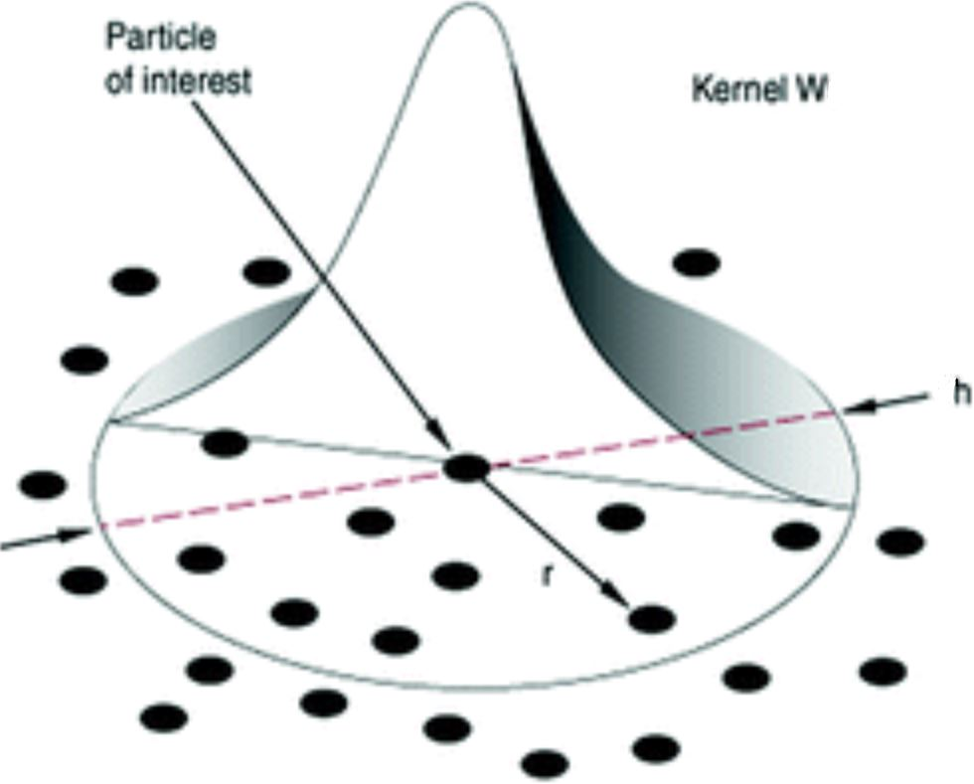
SPH: basics
Mesh-free, particle method
$f\left(r\right)≈<f\left(r\right)>≔\int_{Ω}{f\left(r^{′}\right)W\left(r−r^{′},h\right)dr^{′}}$
Motivation
Rheology
SPH
Methods
Numerical experiments
Research
questions

Slide 9
SPH: basics
Two important conditions:
$\int_{Ω}{f\left(r^{′}\right)W\left(r−r^{′},h\right)dr′}$ = 1 (Unity)
$W\left(r−r^{′},h\right)→δ\left(r\right) for h→0$ (Dirac delta approx.)
The discretized form ($<f\left(r\right)>≔\int_{Ω}{f\left(r^{′}\right)W\left(r−r^{′},h\right)dr^{′}}$):
$<f\left(r\right)>≈\sum_{j=1}^{N}{f\left(r_{j}\right)W\left(r_{i}−r_{j},h\right)}ΔV_{j}$
$ΔV_{j}=\frac{m_{j}}{ρ_{j}}$
Exact gradient:
$<∇⋅f\left(r\right)>≈$ $\sum_{j=1}^{N}{\frac{m_{j}}{ρ_{j}}f\left(r_{j}\right){⋅∇}_{i}W\left(r_{i}−r_{j},h\right)}$
Motivation
Rheology
SPH
Methods
Numerical experiments
Research
questions

Slide 10
SPH: Incompressible SPH (ISPH)
Incompressiblilty (conservation of mass):
$∇⋅u=0$
Predictor step:
$u_{i}^{∗}=u_{i}^{n}+(μΔu_{i}^{n}+{Fn}_{surf,i})\frac{Δt}{ρ}$
Corrector step (enforce incompressiblilty):
$∇⋅{\left(\frac{1}{ρ}{∇p}^{n+1}\right)}_{i}^{}=\frac{∇⋅u_{i}^{∗}}{Δt}$ (Pressure Poisson Equation)
Update step:
$u_{i}^{n+1}=u_{i}^{∗}−{\left(\frac{1}{ρ}{∇p}^{n+1}\right)}_{i}^{}Δt$
$r_{i}^{n+1}=r_{i}^{n}+\left(\frac{u_{i}^{n+1}+u_{i}^{n}}{2}\right)Δt$
Motivation
Rheology
SPH
Methods
Numerical experiments
Research
questions

Slide 11
SPH: discretization terms
Predictor step:
Corrector step (PPE):
Update step:
Motivation
Rheology
SPH
Methods
Numerical experiments
Research
questions

Slide 12
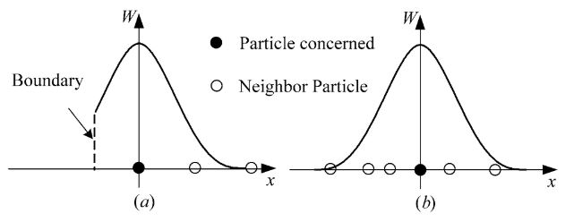
SPH: consistency
$C^{0 }$Consistency (Unity):
$\int_{Ω}{W\left(r−r^{′},h\right)dr′}$=1 $\sum_{j=1}^{N}{W\left(r_{i}−r_{j},h\right)}ΔV_{j}$=1
$C^{1 }$Consistency (Symmetric):
$\int_{Ω}{\left(r−r^{′}\right)f\left(r^{′}\right)W\left(r−r^{′},h\right)dr′}$=0 $\sum_{j=1}^{N}{\left(r_{i}−r_{j}\right)f\left(r_{j}\right)W\left(r_{i}−r_{j},h\right)}ΔV_{j}$=0
Motivation
Rheology
SPH
Methods
Numerical experiments
Research
questions

Slide 13
Methods: Continuum Surface Force (CSF)
Surface tension as a volumetric force:
$F_{surf,i}=σκi{\hat{n}}_{i}|ni|δ_{s}$
$κi=−\left(∇⋅n\right)≈$
$\sum_{j=1}^{N}{\frac{mj}{ρj}{(\hat{n}}_{i}−{\hat{n}}_{j})⋅∇iW\left(r_{i}−r_{j},h\right)}$
$ni=∇ci≈−\sum_{j=1}^{N}{\frac{mj}{ρj}∇iW\left(r_{i}−r_{j},h\right)}$
Advantage:
No tuning needed
Disadvantage:
Curvature calculations are error prone
Motivation
Rheology
SPH
Methods
Numerical experiments
Research
questions

Slide 14
Methods: Particle Interaction Surface Minimization Force (PISMF)
Minimization force (counteracts curvature):
$F_{surf,i}^{}=−γmi\sum_{j=1}^{N}{\left(n_{i}−n_{j}\right)}$
$ni=h\sum_{j=1}^{N}{\frac{mj}{ρj}∇iW\left(r_{i}−r_{j},h\right)}$
Advantages:
Avoids explicit computation of the surface curvature
Avoids normalization of $ni$
Disadvantages:
Requires tuning
Motivation
Rheology
SPH
Methods
Numerical experiments
Research
questions

Slide 15
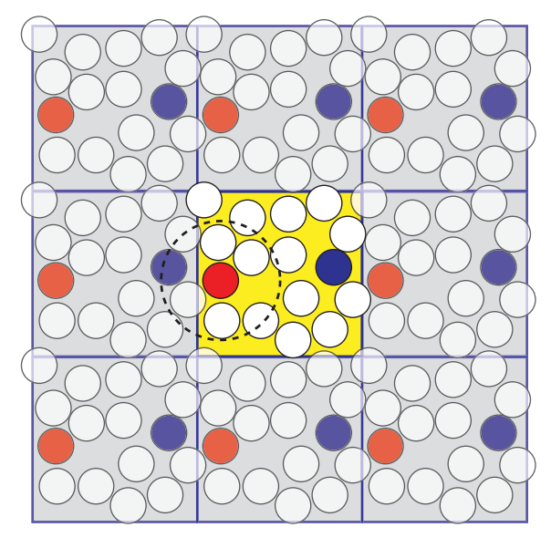
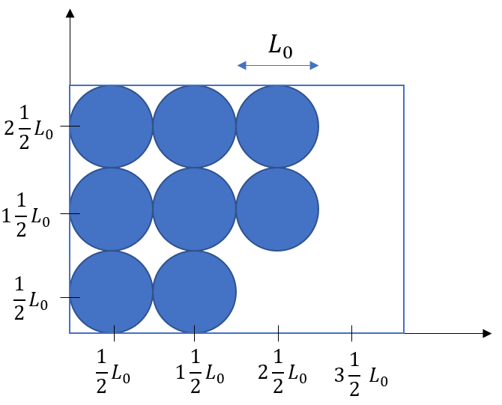
Numerical experiments
Periodic box
$L_{0}=\frac{L_{x}}{N_{particles}}$
Motivation
Rheology
SPH
Methods
Numerical experiments
Research
questions
y
x

Slide 16
Numerical experiments
Stationary droplet (Young-Laplace):
$P_{in}−P_{out}=\frac{σ}{R}$
Oscillating droplet:
$T=2 πR_{e}\sqrt{\frac{R_{e}\left(ρ_{d}+ρ_{l})\right)}{6σ}}$
Motivation
Rheology
SPH
Tuning methods
Numerical experiments
Research
questions

Slide 17
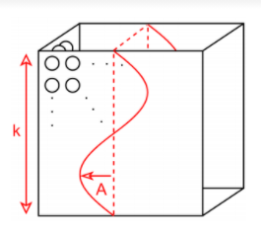
Numerical experiments
SAOS: Small Amplitude Oscillatory Shear
Body force:
Standing wave
Only in the x-direction
$F_{sin}=Asin\left(ly\right)\sin\left(ωt\right)$
Characterizing viscoelastic properties:
Storage modulus G’ and loss modulus G’’
Motivation
Rheology
SPH
Tuning methods
Numerical experiments
Research
questions

Slide 18
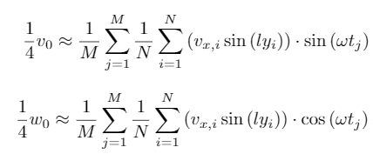
Numerical experiments: SAOS
Storage and loss modulus:
Only unkowns $v_{0}$ and $ω_{0}$:
For Newtonian fluids:
Motivation
Rheology
SPH
Tuning methods
Numerical experiments
Research
questions

Slide 19
Research questions
How can pairwise interaction forces be used to tune the fluid rheology and surface tension independently?
What are advantage and disadvantage of SPH and what is SPH?
What is the influence of using different discrete expressions for the pressure force?
Which methods can be used to tune the surface tension?
What is the effect of particle interaction forces on the surface tension?
How can the surface tension be measured?
Which (analytical) methods can be used to verify the numerical implementations?
For the Newtonian case.
For the viscoelastic case.
What numerical and/or experimental results can be used to test/compare the implementations?
Motivation
Rheology
SPH
Tuning methods
Numerical experiments
Research
questions

