Slide 1
Modelling of River Hydrodynamics with D-Flow Flexible Mesh and 3Di
Preliminary report

Slide 2
Contents
Assumptions Shallow Water Equations
D-Flow Flexible Mesh
3Di
Research Questions
Test models

Slide 3
Assumptions Shallow Water Equations
Starting point Navier-Stokes equations
Neglecting certain processes
Missing diffusion term in 3Di

Slide 4
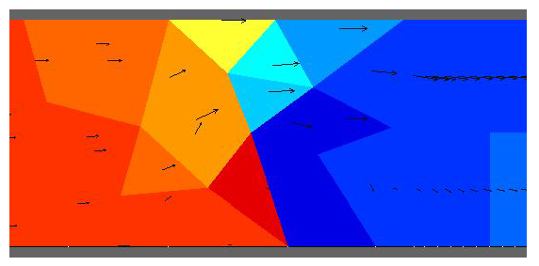
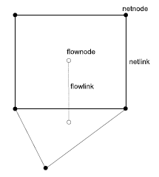
D-Flow Flexible Mesh
Staggered grid
Cell center is the circumcenter

Slide 5
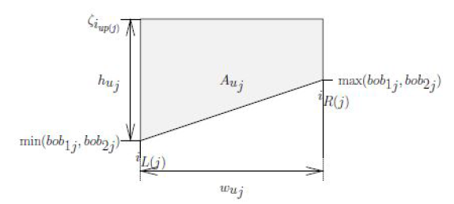
D-Flow Flexible Mesh
Linear bed geometry
No local momentum conservation with triangles

Slide 6
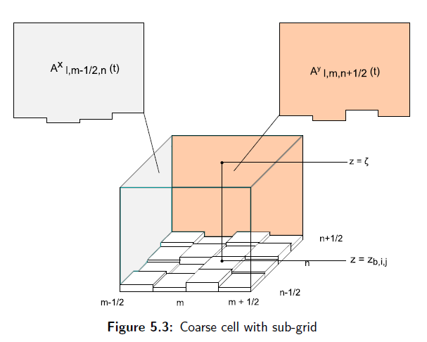
3Di
Staggered Cartesian grid
Sub-grid that contains bottom
information
Local refinement by quadtrees

Slide 7
Research questions
What needs to be considered when modelling 2DH in either D-Flow Flexible Mesh or 3Di?
Hydraulic Engineering Question:
Which processes are determinative for the suitability of D-Flow Flexible
Mesh or 3Di with a specific problem?
Applied Mathematics Question:
How do local grid refinements influence the modelling results of river hydro-
dynamics?

Slide 8
Sub questions HE
What assumptions are done to go from 3D to 2DH?
What are the consequences of these assumptions?
What are the errors in models due to the assumptions?
If the results differ in both models, where do these differences come from?

Slide 9
Sub questions AM
How are the grids refined?
Are the results depended on the grid itself?
What are the errors due to the numerical approximation?
What is the amount of work needed to do these refinements?

Slide 10
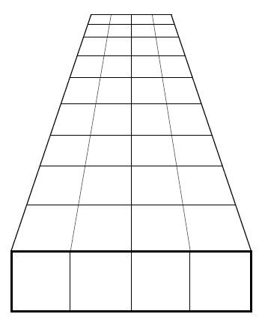
Test Model: Straight channel with rectangular cross section
Understand both programs
Use it to test matlab files
Add fixed weir for understanding its effect

Slide 11
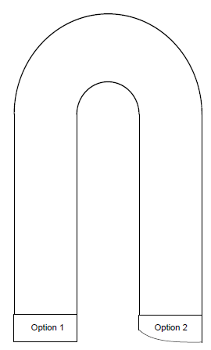
Test Model: U-bend
Model will differ in both programs
Gain better insight in storage 3Di
Two different cross sections
Gain better insight in velocities

Slide 12
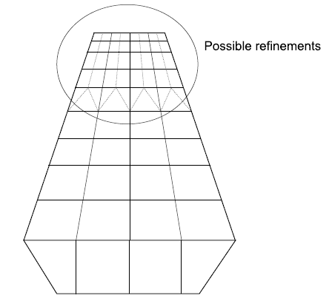
Test Model: Straight channel with trapeziodal cross section
Testing convergence
Apply local grid refinements
Add fixed weirs
Try different types of conveyance

Slide 13
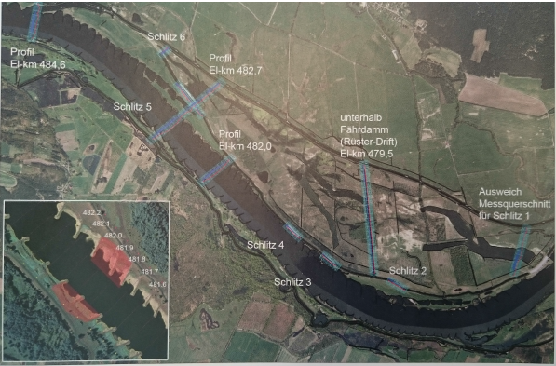
River Elbe
Many measurements done
Old project BAW
Both water level
measurements as velocity
measurement

