Slide 1
Overtopping failure in levees
Michaël Mersie
Delft University of Technology
December 16, 2020

Slide 3
What will happen?

Slide 4
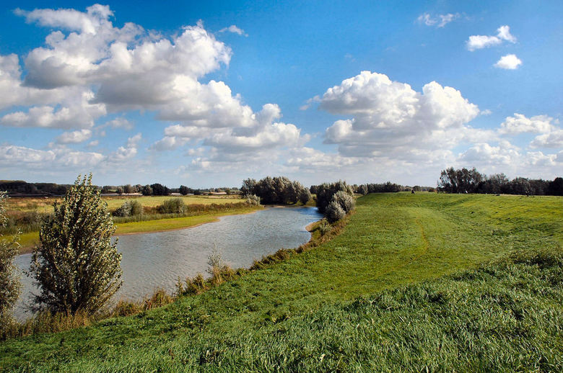
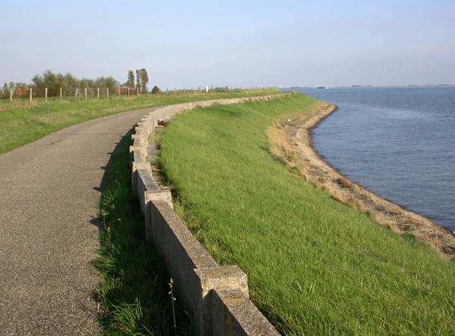
Predominant damping factor?
source: Rijkswaterstaat, Zoom.nl

Slide 5
Table of contents
Problem
Current methods
New proposed method
Finite element approach
Future work
source: Rijkswaterstaat, Zoom.nl

Slide 6
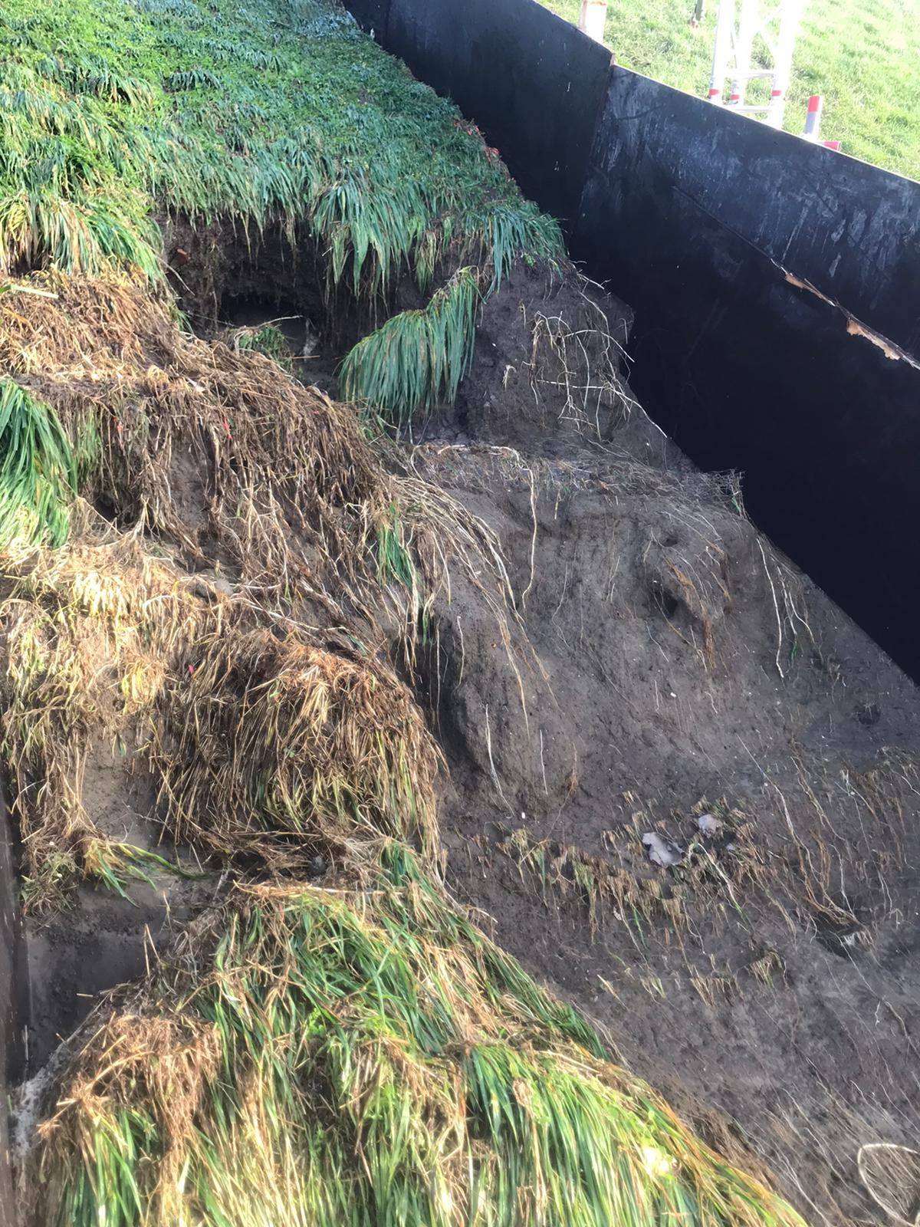
Problem
source: Rijkswaterstaat

Slide 7
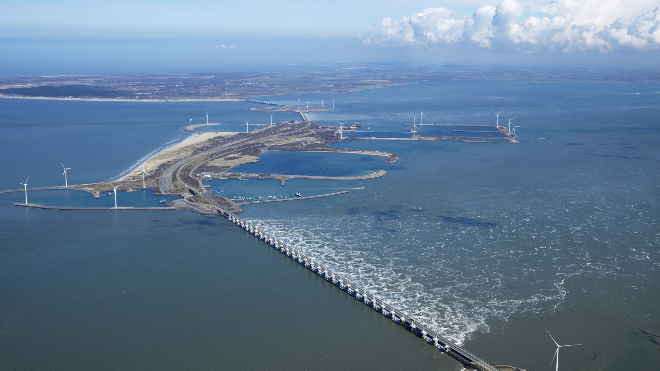
Problem
Stability of flood embankments
Local soil
source: E-Connection

Slide 8
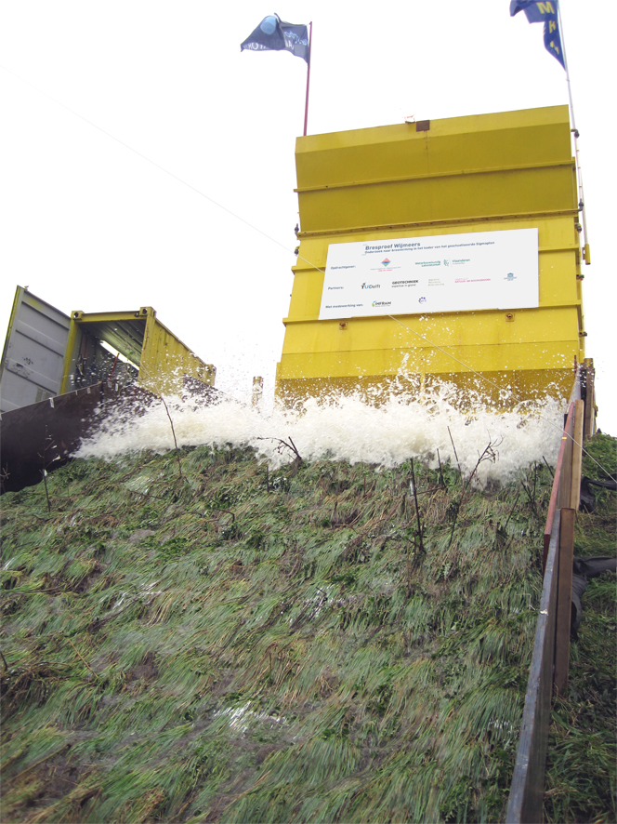
Current methods
Wave overtopping simulator
expensive
PORO-WSSI
based on porous seabed
does not match reality
pore water carries load
source: Waterbouwkundig Laboratorium

Slide 9
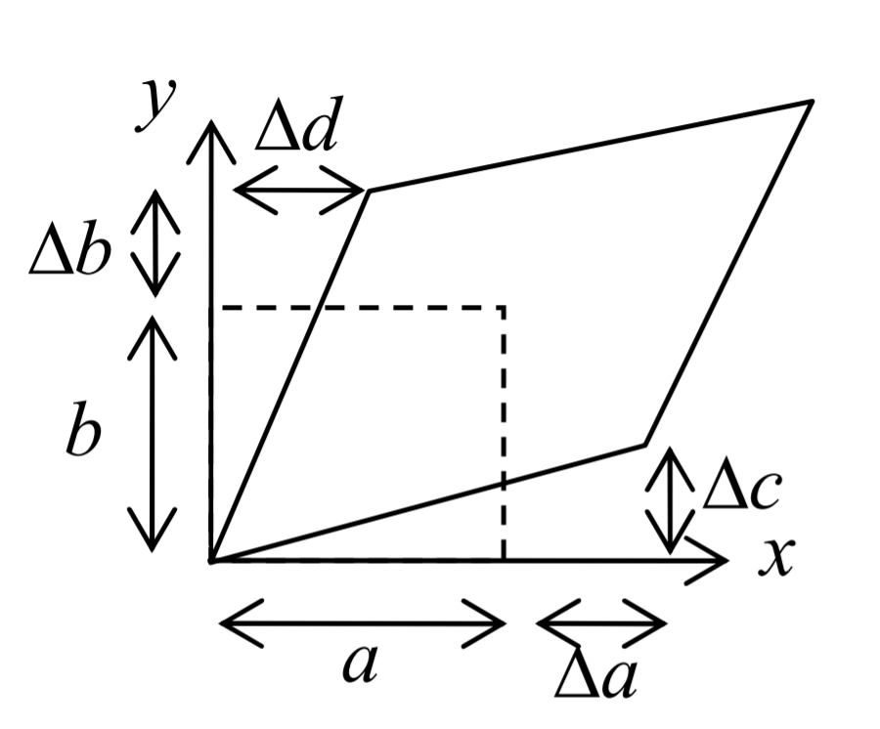
New proposed method
Solving for five variables:
$ε_{\text{vol}}$
$ω$
$P$
$u_{x}$
$u_{z}$

Slide 10
Virtual work

Slide 11
Domain

Slide 12
Resulting PDEs

Slide 13
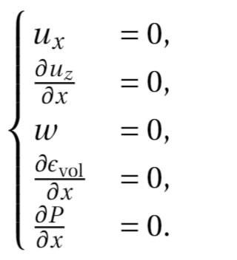
BC for $x=0 \text{and} x=L$

Slide 14
BC for $z=0$

Slide 15
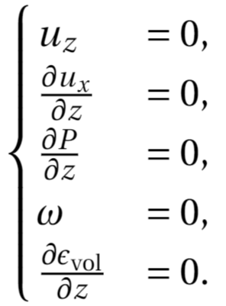
BC for $z=−Z$

Slide 16
Differences $z=0$
New model $$−βε_{vol}−α\frac{∂u_{z}}{∂z}+P= σ_{zz}$$ | PORO-WSSI $$P= σ_{zz}$$

Slide 17
Differences $z=−Z$
New model $$\frac{∂u_{x}}{∂z}=0$$ | PORO-WSSI $$u_{x}=0$$

Slide 18
Initial conditions
Waves start after some time $t_{1}>0$
Stationary trivial situation

Slide 19
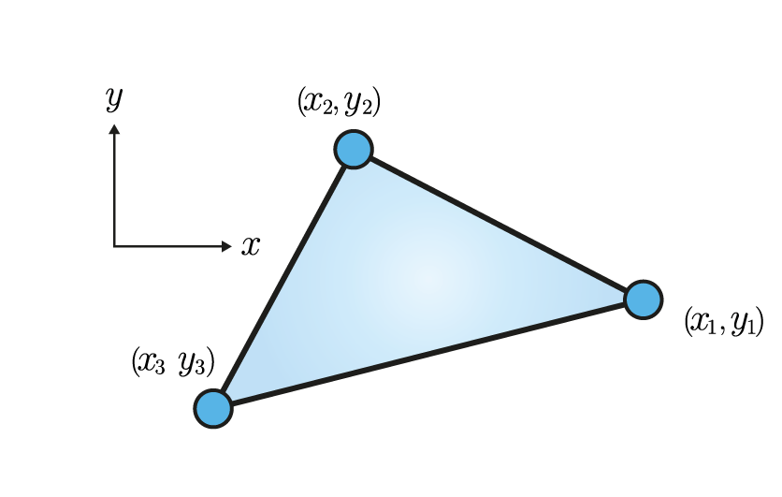
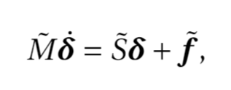
Finite Element approach
P1 elements
source: de Mechanica

Slide 20
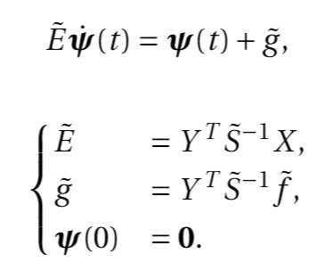
Singular matrix $\tilde{M}$
Matrix decomposition (van Ophem et al.)
Defining new state variable

Slide 21
Time integration
Crank-Nicolson Method
Modified Euler Method

Slide 22
Future work
Implementation of FE model
Verification
Parameter analysis
Extension:
More complex domain
Accelerations
Solving for porosity

Slide 23
Thank you for your attention!
Michaël Mersie
m.l.j.mersie@student.tudelft.nl
michael.mersie@rws.nl

